Slide 1
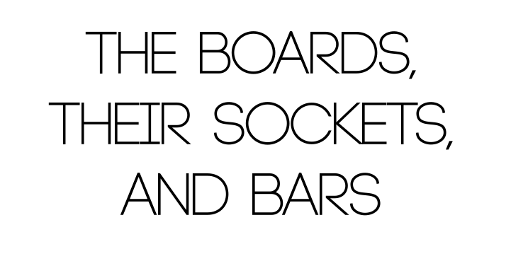

Slide 3
The Tabernacle consisted of a framework of 48 boards overlaid with gold.
These boards stood in 96 sockets of silver and were braced by five bars on each of its three closed sides.
The door and veil divided the structure into two compartments:
The Holy Place (10 cubits wide by 20 cubits long by 10 cubits high),
The Most Holy Place (10 cubits in each measurement, forming a perfect cube).

Slide 5
"And thou shalt make boards for the Tabernacle of shittim wood..."Exodus
26:15).
Shittim wood comes from the shittah tree.
The wood is very knotty and full of gnarls, not growing straight.

Slide 6
".. standing up" (Exodus 26:15).
Each board was to be standing up upright before the Lord.
Each member of the body is to "stand fast in the faith; stand fast in the Spirit; stand fast in the Lord; stand perfect and complete; and having done all to stand, stand..."

Slide 7
"Ten cubits shall be the length of the board, and a cubit and a half shall be the width of the board" (Exodus 26:16).
Each board to be overlaid with gold, and measure up to Divine standards.
The boards were to be ten cubits high.

Slide 8
The number ten represents trial, testing, law, order and responsibility.
Ex: Ten Commandments, the Ten Talents and the Ten Virgins.
The width of the boards is identical to the measurement of height for the Grate of the Brazen Altar, The Table of Shewbread and the Mercy Seat on the Ark of the Covenant.

Slide 9
"Two tenons shall there be on one board" (Exodus 26:17).
These two tenons enabled the board to stand upright and securely in its own place in the sockets.
There are two tenants of the Apostolic Faith that were exposed whenever the apostles preached: Christ's Death and His Resurrection.
When a believer believes this, he will walk a balanced, steadfast life in the Holy Spirit.

Slide 10
"Set in order one against the other: Thus shalt thou make for all the boards of the Tabernacle" (Exodus 26:18).
The Boards were to stand upright on their own, and yet they stood collectively to make up the dwelling place for the Lord.
No single board could make up a fit dwelling for Jehovah.
Every Board had its place.
Each Board needed the support of the other Boards.
The Glory of the Lord could only dwell in a unified building.
Ephesians 2:22, 4:3, 13 and 1 Corinthians 12:12-18

Slide 11
The forty-eight boards were positioned thusly:
20 Boards for the South and North side
6 Boards for the West side
2 Boards for the corners on the West end
48 Boards
The corner Boards were supported by coupling rings which were to be beneath and above the Corner Boards.

Slide 12
"And thou shalt overlay the Boards with gold..." (Exodus 26:29).
The boards were overlaid with gold, which represents the deity of Christ and also the church is covered with His beauty, 2 Corinthians 5:17.
The church is the body of Christ, covered with His glory.
Christ is within us (Colossians 1:27), and yet we are in Him (2 Corinthians 5:17).

Slide 13
THE SOCKETS: (Exodus 26:19-22, 25)

Slide 14
For each of the 48 boards, there were two sockets of silver.
There were:
40 Sockets for the 20 boards on the south side,
40 Sockets for the 20 boards on the north side,
16 Sockets for the 8 boards on the west side,
96 Sockets total.
These Sockets were the very foundation of the Tabernacle.
1Corinthians 3:9-14
It is absolutely essential to lay a proper and firm foundation.

Slide 16
On each side of the structure there were positioned five bars of Shittim wood overlaid with gold.
These were 15 bars in all, five on each wall.
Four bars were run through the golden rings.
The fifth bar was run through the middle of the boards.

Slide 17
The bars completed the structure, giving it the necessary strength.
The bars very well could represent the five-fold ministry that was given for the edifying of the entire body of Christ (Ephesians 4:11-16).
Just as the Tabernacle could withstand winds that blew against it, so the ministries keep the church from being swayed by every wind of doctrine.

