Slide 1
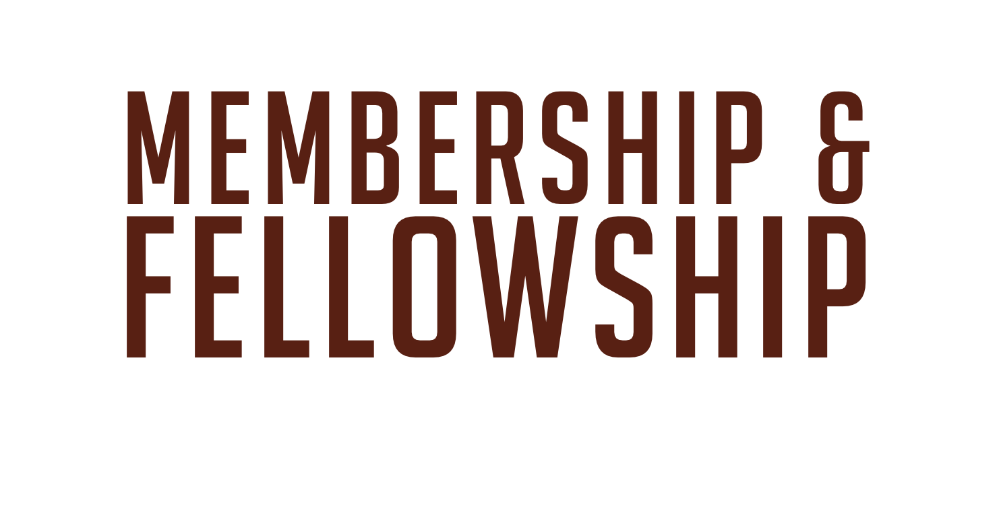

Slide 2
Pentecostal Saints Should Unite Together To Form Assemblies
The problem often arises when the gospel is preached in a new community whether or not the new converts will be able to continue worshipping in their former churches.
This is contrary to the will of God.
When believers have received the Holy Ghost, it is wrong to bury themselves in congregations where they are not accepted, where they will receive little or no spiritual help.

Slide 3
Pentecostal Saints Should Unite Together To Form Assemblies
"What fellowship hath righteousness with unrighteousness, and what communion hath light with darkness? ...Wherefore come out from among them and be ye separate saith the Lord" (II Corinthians 6:14-17).
The Baptism of the Holy Ghost places the believers into one body and calls them out of the world to form an assembly.
He also states that the Holy Ghost has set over the flock, overseers or bishops, to feed the church.

Slide 4
Church Membership is Necessary in Large Churches
In rural or small churches the pastor may not find it necessary to take steps in organizing or setting the church in order other than teaching the saints the Word of God.
Many problems arise in large and urban churches, which makes it necessary for the church to be thoroughly set in order and to be well organized.
To have one's name written in the Lamb's Book of Life is the great necessity and is quite sufficient. Membership cannot save.

Slide 5
Many Reasons May Be Given For Church Membership
Here are a few reasons why a church should have a membership roll:
Every local assembly membership roll should only be a copy of a part of the Roll in heaven.
By being a member of a church the Pentecostal saint brings practical encouragement to fellow believers of like precious faith and testifies to the world that the church is united in faith and doctrine.

Slide 6
Many Reasons May Be Given For Church Membership
Church membership places spiritual and financial responsibilities upon the entire body, which will be shared among all and not born by a few.
It confines various forms of Christian service to recognized and responsible members.
It is the "members" of the pastor’s "flock" that he is definitely responsible for before God.
Church discipline becomes almost impossible without a membership roll.
Church membership safeguards the public testimony of the assembly
Every child of God should be a member of a "flock" and have a spiritual home where they can receive proper and prayerful spiritual shepherding.

Slide 7
Many Reasons May Be Given For Church Membership
Church membership places spiritual and financial responsibilities upon the entire body, which will be shared among all and not born by a few.
It confines various forms of Christian service to recognized and responsible members.
It is the "members" of the pastor’s "flock" that he is definitely responsible for before God.
Church discipline becomes almost impossible without a membership roll.
Church membership safeguards the public testimony of the assembly
Every child of God should be a member of a "flock" and have a spiritual home where they can receive proper and prayerful spiritual shepherding.

Slide 8
Fellowship and Unity are Essential to an Assembly
Saints do not lose their individualism when they are converted.
People coming from different walks of life are thrown together continually in church.
The Apostle Paul, realizing this, exhorted the Ephesian church to "endeavor" to keep the unity of the Spirit.
Fellowship is an intimate relationship in which there is a common sharing and spiritual communion.
There can be no fellowship between light and darkness, righteousness and sin, good and evil.

Slide 9
The Pastor May Remember Some Simple Rules in Preserving Unity
It is part of the work of shepherding a flock to carefully foster the spirit of unity and to be on the watch for any sign of anything, which would break the spirit of fellowship existing in an assembly.

Slide 10
The Pastor May Remember Some Simple Rules in Preserving Unity
Here are a few simple rules to remember:
Give the assembly regular teaching on unity.
Keep the saints busy working for Jesus.
Never show favoritism.
All signs of divisions and difficulties should be carefully and prayerfully dealt with immediately.
Keep all finances and business in a straightforward manner.
Visit the assembly regularly and faithfully.

