Slide 1
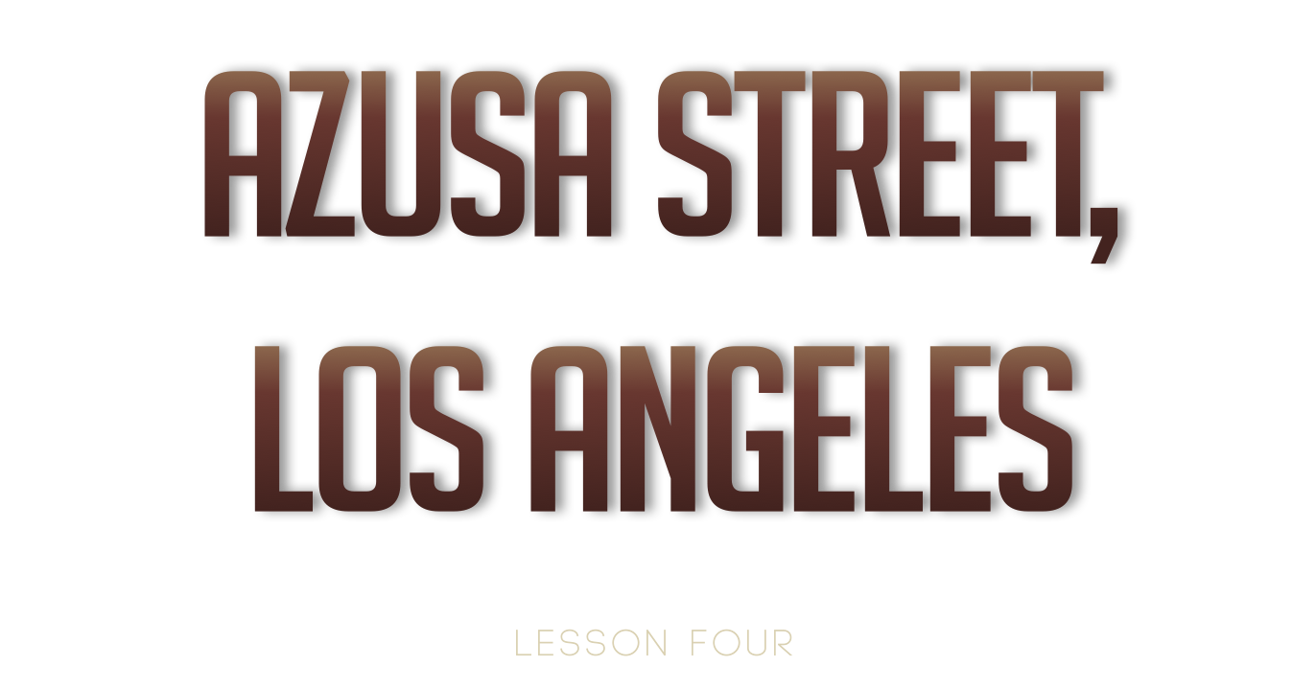

Slide 2
W. J. Seymour
December 1905
Parham rents a house, opens Bible School
Classes began after the New Year of 1906

Slide 3
W. J. Seymour
W.J. Seymour was among the students
Did not have the Holy Ghost but believed it was scriptural
Invited to hold a meeting in a L.A. Nazarene church
In first sermon, preached Acts 2:4
The church didn’t take it well, decided it was heresy

Slide 4
Bonnie Brae Street
Seymour was invited to conduct prayer meetings in a Baptist couple’s home
Each night, a group of souls met for prayer
On April 9, 1906, 7 rec’d the Holy Ghost
For 3 days, 3 nights the service cont’d w/ people coming from everywhere
All races
Entire city was stirred
Sinners were converted, sick bodies healed

Slide 5
Azusa Street
Moved to Azusa St. because of the crowds
Old discarded building
Had been vacant for years
Two-story frame building
Upper level was a tenement house,
Lower floor was a large unplastered room

Slide 6
Azusa Street
The Facts
Revival lasted for 3 years
Services lasted from 10 am – 12 midnight
No advertising
No sponsoring organization
No instruments, no choir
No offerings
Everyone was equal regardless of race, education, economic status

Slide 7
Azusa Street
W. J. Seymour
Sat behind two empty shoeboxes
No subject/sermons announced in advance
Everything was spontaneous led by the Spirit

Slide 8
Azusa Street
Who all came to Azusa Street?
People came by the thousands from all over the globe
All religious faiths and denominations
Every class, race, culture
People returned home preaching the Pentecostal Truth and spread the Truth around the globe

Slide 9
Why was Azusa so important?
Location
Publicity
Foundation of Truth
Persecution

Slide 10
Result of Azusa Revival
Churches split over this experience
Who took a stand against the revival?
Church of the Nazarene
Missionary Alliance
Who stood in support of the revival?
Pentecostal Holiness Church
Church of God
Some of the Godliest men of denominations were attracted to the revival

Slide 11
Result of Azusa Revival
Pentecostal Revival rec’d certain char. from the Holiness Churches
Open Altar
Tarrying services
Camp Meetings
Name of the Revival
Apostolic Faith – most common
Pentecostal

