Slide 1
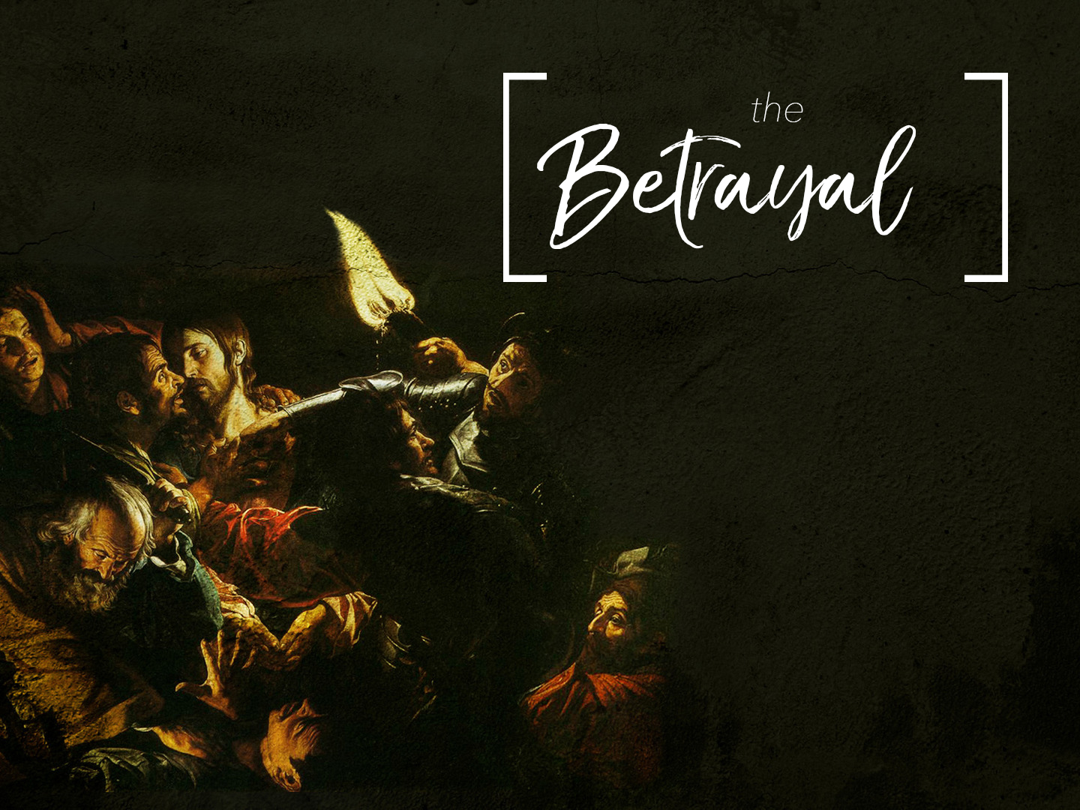

Slide 2
Judas Iscariot:
Judas Iscariot was one of the twelve disciples.
His father was Simon Iscariot.
His motive in following Jesus would seem to be of a mercenary nature expecting to gain a worldly advantage in the establishment of the kingdom.
When we study his character we are quite surprised that he could have been one of the twelve:

Slide 3
Judas Iscariot:
He was greedy of gain and desirous of money
  Matthew 26:14-15
He was hypocritical
  John 12:5-6
He was a thief
  John 12:6
He was guilty of treachery
  Mark 14:10
  Luke 22:47-48

Slide 4
Judas Iscariot:
In spite of the above characteristics we must consider the fact that Judas felt genuine remorse (Matthew 27:3-4)
This would tell us that everything about Judas was not all bad
Finally, we should consider his title as given by our Lord in speaking of Judas

Slide 5
Judas Iscariot:
"Those that thou gavest me I have kept, and none of them is lost, but the son of perdition; that the scripture might be fulfilled" (John 17:12)
This title "son of perdition" is also given to Antichrist who is to be revealed (II Thessalonians 2:3)

Slide 6
Judas Iscariot:
The meaning of this title is literally, "man destined to be lost in eternal damnation”
It is quite significant that both Judas and the Antichrist are given this title revealing the awful final destiny of both of them, which was ordained by God

Slide 7
The Act of Betrayal:
Judas was full of criticism when Mary anointed the feet of Jesus with expensive perfume (John 12:1-8)
He felt that what Mary did was a complete waste
Jesus defended Mary and rebuked Judas for his criticism

Slide 8
The Act of Betrayal:
Undoubtedly Judas had previously considered the thought of furthering his own ends by selling
Jesus into the hands of His enemies
This rebuke from the Master apparently settled it.
He would no longer postpone his dastardly act

Slide 9
The Act of Betrayal:
While the supper was in progress in the home of Simon the Sanhedrin was gathered in the palace of Caiphas, planning and plotting how they might kill Jesus
Judas left the supper and hastened to the palace arriving there just at the right moment
The hearts of these religious politicians were filled with wicked glee when they learned that one of the twelve would betray Jesus into their hands

Slide 10
The Price of a Slave:
Judas quickly came to an agreement with the Sanhedrin although he undoubtedly was disappointed with what they offered him
Very likely his guilt and the knowledge of his treacherous act caused him to act in haste
The amount agreed upon was the price of a slave, thirty pieces of silver

Slide 11
The Price of a Slave:
It is not possible to state exactly just what this would amount to in present day currency
After consulting two references on this matter the writer has concluded that this amount would be around twenty dollars ($20.00)
It is difficult to understand just how Judas would be willing to sell our Lord for such a small sum

Slide 12
The Act Of Treachery Revealed:
Judas appeared to have concealed his treachery
However, during the supper Jesus revealed the fact that he was aware of it by saying, "One of you shall betray me"
Jesus showed that He knew who it was who would betray Him by handing a sop to Judas and telling "That him, thou doest, do quickly"

Slide 13
The Act Of Treachery Revealed:
This certainly teaches that it is impossible to hide any wrong act from our Lord
He knows every sin whether small or great
"Satan entered into him" (John 13:27)
Some have tried to prove by this statement that at this point Judas became the Devil Incarnate
However, this is very doubtful

Slide 14
The Act Of Treachery Revealed:
It seems the that meaning here is that Satan took complete control
In a similar manner Satan enters into men today and takes complete control
The soul of Judas who had been a disciple for three years now became completely possessed to do the will of Satan

Slide 15
Betrayed By A Kiss:
He knew that doubtless he would find Him in Gethsemane praying
It certainly showed just how low Judas had fallen that he would betray Jesus in the place of secret prayer
This was deliberately planned that He might be arrested in a quiet place in the middle of the night in order to avoid a tumult with the public

Slide 16
Betrayed By A Kiss:
Judas led the soldiers into the garden and then identified him with the sign, which had been prearranged
This sign was to be a kiss, which was probably the usual salutation of the disciples
This act of betrayal revealed once again just how low Judas had fallen

Slide 17
The Price of Betrayal:
The true price of betrayal had not yet been paid
It was not the thirty pieces of silver but rather the price that Judas himself had to pay
In the confusion of that night we do not know just what Judas did following the betrayal
However, soon came that awful sense of guilt, remorse and shame that always follow such acts of wickedness and shame

Slide 18
The Price of Betrayal:
Judas was overcome with a sense of condemnation
He repented and he attempted to make restitution
He carried back the silver to the chief priests and confessed his sin
They refused to acknowledge any responsibility for his act and Judas threw the money upon the pavement of the Temple

Slide 19
The Price of Betrayal:
Judas then went out and committed suicide, hanging himself
The priests purchased with the money the potter's field without the city as a burial-place for strangers
It is implied that the field was where Judas committed suicide and therefore was a double memorial of the betrayal

Slide 20
The Price of Betrayal:
It was called, Aceldama, or the field of blood (Matthew 27:3- 10 & Acts 1:18-19)
The following words sum up the tragic life of Judas with some awful, fearful meaning: "That he might go to his own place" (Acts 1:25)

