Slide 1
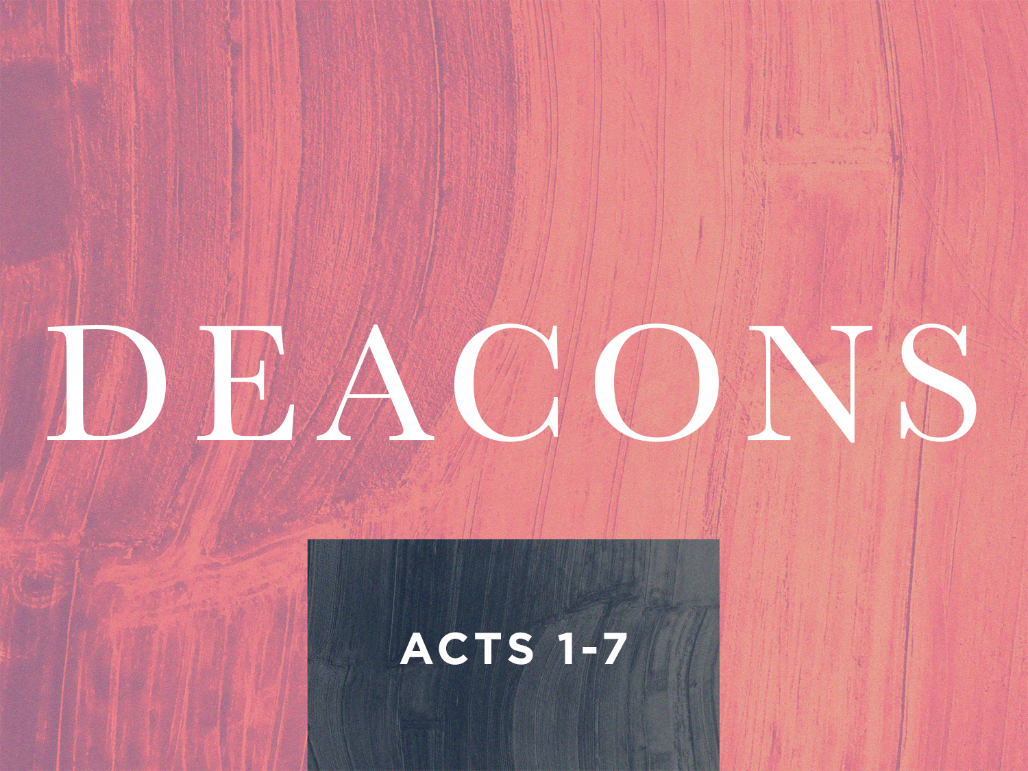

Slide 2
The Grecians:
Acts 6:1
They were Jews, just as the Hebrews
The Grecian Jews were Jews who were living abroad and were visiting Jerusalem at the time of Pentecost
They spoke Greek and were greatly influenced by Greek culture
For this reason they were called Grecian Jews or Hellenists

Slide 3
Church Government:
"God hath set some in the church, first apostles, secondarily prophets... governments, diversities of tongues" (I Corinthians 12:28)

Slide 4
Church Government:
The word "governments" refer to the power of ruling, the organized control that God has placed in the church for the maintenance of order among the saints
The Lord has placed certain offices and ministries in the church to govern the church (Ephesians 4:11)

Slide 5
The Deacons:
"It said, is not reason that we should leave the word of God and serve tables."
Their work was to give themselves continually to prayer and to the ministry of the Word.

Slide 6
The Deacons:
The names of the seven deacons were Stephen, Philip, Prochorus, Nicanor, Timon, Pramenas and Nicolas
(1) The apostles gave the qualifications; (2) The church did the choosing or electing; and (3) The apostles appointed them or ordained them

Slide 7
Qualifications of Deacons:
Acts 6:3: qualifications for the deacons:
1. MEN: The Greek word used here is the specific one, which meant males
2. AMONG YOU: They had to be in the church

Slide 8
Qualifications of Deacons:
3. OF HONEST REPORT: They had to have a good reputation
4. FULL OF THE HOLY GHOST
5. FULL OF WISDOM: They had to be men of maturity

Slide 9
Qualifications of Deacons:
I Timothy 3:8-13 gives further qualification stated:
1. Must be grave
2. Must not be double-tongued
3. Not given to much wine
4. Not greedy of filthy lucre

Slide 10
Qualifications of Deacons:
5. Hold the mystery of the faith in a pure conscience
6. They must first be proved
7. They must be blameless'
8. Husbands of one wife
9. They must rule their children and houses well

Slide 11
The Results of This Event:
Acts 6:7: the Word of God increased the number of disciples multiplied and even a company of priests believed and were saved
This revival took place because unity had been restored
At least two of the deacons became powerful evangelists: Stephen and Philip

