Slide 1
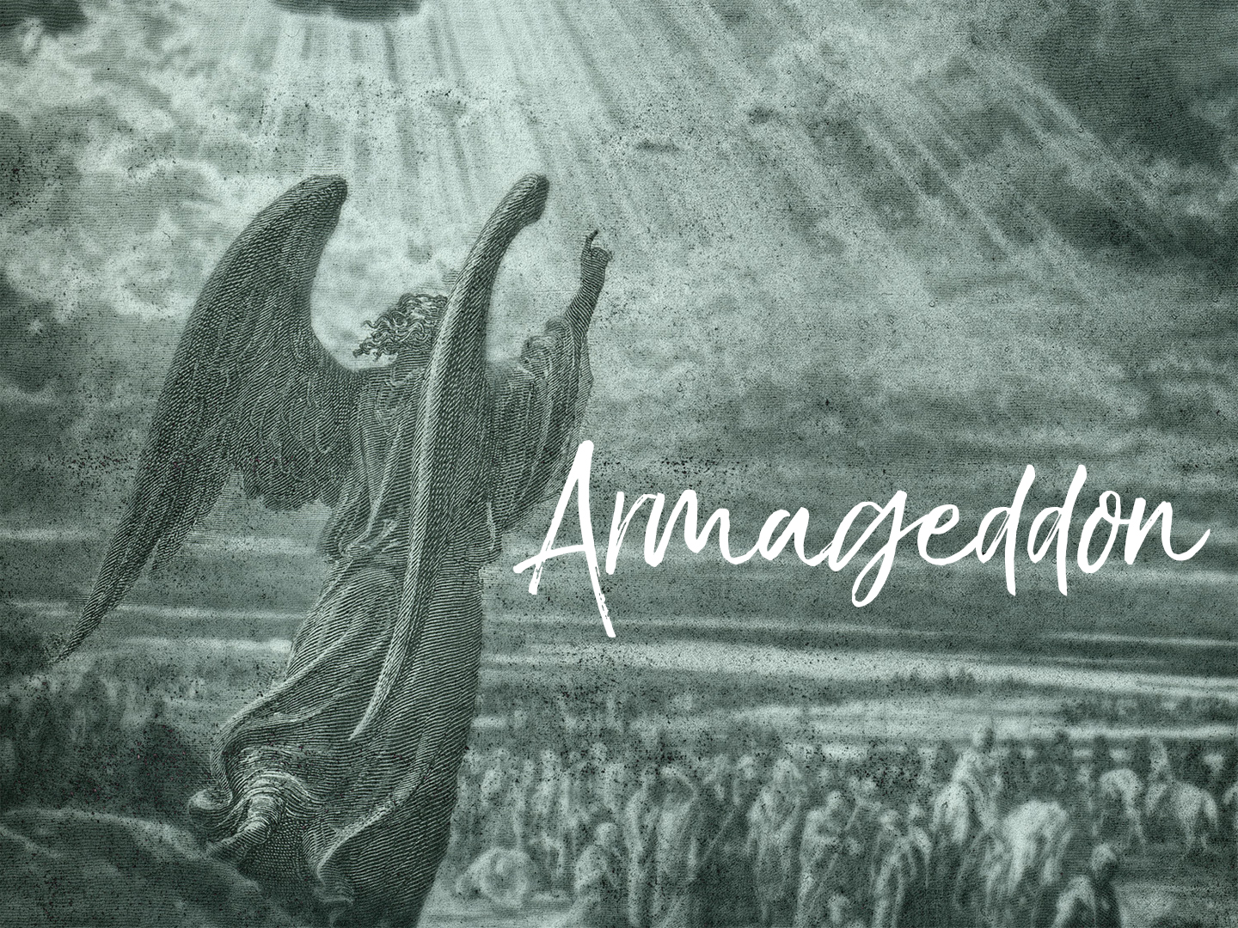

Slide 2
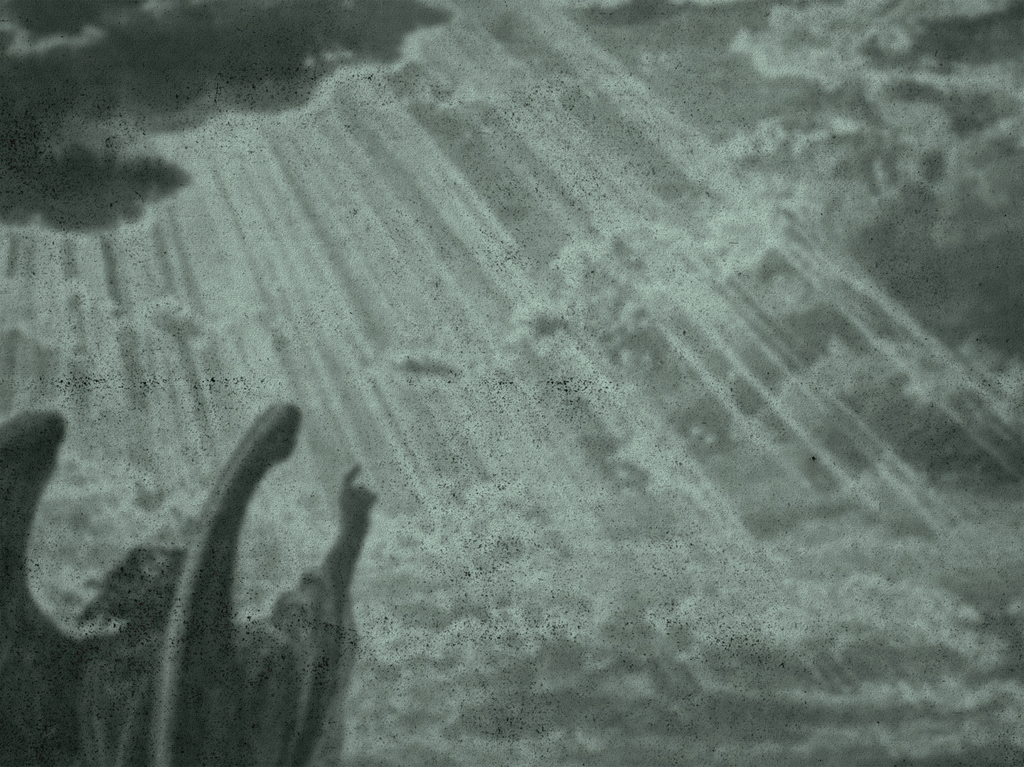
Armageddon
Revelation 19:11-21
The word "Armageddon" Hebrew word meaning "the hills of Megiddo"
This was the main highway between Asia and Africa, the meeting place of armies from the East and the West
It is claimed that more blood has been shed here than any other spot on earth

Slide 3
Armageddon
This will be the scene of the final decisive battle between Antichrist and Christ
It is here that the stone will smite the ten-toed kingdoms as described in the second chapter of the prophecy of Daniel
The smitten Christ of Calvary will become the smiting stone

Slide 4
Armageddon
This valley is approximately ten miles by forty miles in length
It should be noted that in Revelation 14:20, blood is to come out of the winepress for the distance of 1,600 furlongs

Slide 5
Armageddon
To explain this we need to read in Isaiah 63:1 that Christ comes from Boxrah, the capital of Edom
From this we can conclude that the Battle of Armageddon will involve the whole land of Palestine but the Valley of Jehoshaphat will be the focal point
It is at this battle that the tribulation ends and the millennium begins

Slide 6
Armageddon Described In Revelation
Revelation 14: 14-20:
Armageddon does not take place until the end of the Tribulation with the pouring forth of the seventh bowl judgment
Jesus is seen sitting upon a white cloud, wearing a crown of gold and holding in His hand a sharp sickle
Three angels are seen coming out of the temple, each in turn crying to Jesus to thrust in the sharp sickly and reap the ripened clusters of grapes

Slide 7
Armageddon Described In Revelation
The nations are likened to grapes to be harvested and thrown into a great winepress
A winepress is a big vat for the treading of grapes to be crushed in order to release the juice
Here the wicked are cast into a winepress and are trampled by our Lord Himself

Slide 8
Armageddon Described In Revelation
Just as the grape juice stains the clothes of the one who is doing the trampling, so the garments of Jesus is stained by the blood which will splash as high as the horses' bridles or four feet

Slide 9
Armageddon Described In Revelation
Revelation 16:16-21:
The battle takes place with the pouring forth of the seventh vial judgment
There is a great earthquake accompanied with thunder, lightning and hailstones falling, which weigh around 100 lbs. each
Islands and mountains disappear and there is a great change upon the surface of the earth

Slide 10
Armageddon Described In Revelation
Revelation 19:11-21:
John saw heaven opened (19:11).
Here a door again is opened when Jesus will come with His saints.
This is the Revelation of Christ at His Second Coming

Slide 11
Armageddon Described In Revelation
He is seen coming on a white horse accompanied with the armies of heaven also riding on white horses and clothed in fine linen
It should be noted that only Christ does the fighting
The armies of heaven are simply spectators

Slide 12
Armageddon Described In Revelation
Jesus is called Faithful and True, and is clothed in a vesture dipped in blood
In the battle Jesus smites the nations with a sharp sword which proceeds from His mouth
He treads the winepress of the wrath of God
He shall rule the nations with a rod of iron

Slide 13
Armageddon Described In Revelation
The beast and the false prophet are thrown alive into the lake of fire
The rest of the armies are slain with the sword and their bodies are left rotting upon the plain
An angel calls for all the vultures and carrion eaters to come to feast on the flesh of kings, captains and mighty men
This is called the supper of the great God

Slide 14
Armageddon Described
In Other Scriptures
Isaiah 63:1-6:
Here Armageddon is likened to a winepress, which is trodden by Jesus Christ
It is plainly stated that Jesus alone will destroy his enemies and gain the victory
Although other Scriptures state that He will be accompanied by the Saints, yet He alone fights the battle and gains the victory
It is His garments, which will be stained with the blood of His enemies

Slide 15
Armageddon Described
In Other Scriptures
Joel 3:9-17:
The prophet stated that here the Lord will judge the nations
Also is described the signs that will take place in the sun, moon and stars

Slide 16
Armageddon Described
In Other Scriptures
Matthew 25:31-46:
This is not the Great White Throne Judgment described here but rather the judgment that will take place at His Second Coming
It is known as the judgment of the nations
It is here that Jesus Christ will return to earth and will set up His Kingdom for one thousand years

Slide 17
Armageddon Described
In Other Scriptures
II Thessalonians 1:6-10:
The apostle Paul gave a description of our Lord's revelation at His Second Coming
He shall be revealed: with His mighty angels; in flaming fire; taking vengeance on them that know not God; He shall be glorified in His saints and admired by all that believe

Slide 18
The Battle Of Armageddon
At the battle of Armageddon the Beast, the head of the revived Roman Empire, will lead the armies, which come up against Jerusalem
The plains of Esdraelon will be filled with soldiers and the hills will swarm with armed men
The unclean spirits, working miracles, will have deceived the nations and brought them together to destroy Jerusalem

Slide 19
The Battle Of Armageddon
The battle is a short one
  The Lord appears and there is one mighty blow from above
  One flash of glory and the battle is over

Slide 20
The Battle Of Armageddon
Nebuchadnezzar saw a stone cut out of the mountain without hands (Daniel 2:34) which smote the image upon its feet and broke them to pieces
The accomplishment of this act will take place at the Battle of Armageddon
At this moment the Gentile Kingdoms of the Antichrist will be destroyed

Slide 21
Final Results Of Armageddon
There will be several immediate results of this great final battle, which may be listed:
  The armies of Antichrist, which will come up against Jerusalem, will be destroyed;
  The Beast and the False Prophet will be thrown alive into the Lake of Fire;
  The rotting bodies of the slain enemies will be eaten by vultures assembled from far and near;

Slide 22
Final Results Of Armageddon
  Jesus will come to the earth upon the Mount of Olives (Zechariah 14:4) and the mount shall cleave asunder;
  The devil is bound and locked up in the bottomless pit for 1,000 years;
  At this time Jesus will institute His Kingdom upon earth with Jerusalem as being the capital

