Slide 1
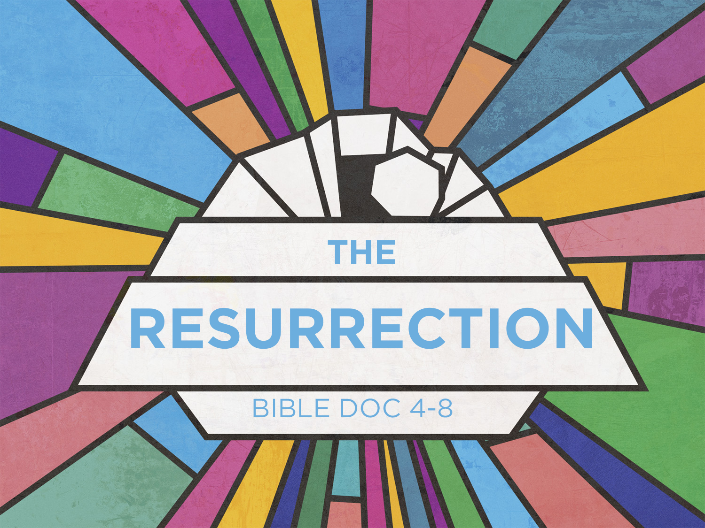

Slide 2
The Resurrection Taught In Scripture
TAUGHT IN THE OLD TESTAMENT
In Word- Job 19:25-27; Psalm 16:9; Psalm 17:15; and Daniel12:1-3
In Figure- Genesis 22:5 with Hebrews 11:19
In Prophecy- Isaiah 26:19, Hosea 13:14
In Reality- II Kings 4:32-35; II Kings 13:21

Slide 3
The Resurrection Taught In Scripture
TAUGHT IN THE NEW TESTAMENT
In Word-Jesus- John 5:28-29; John 6:39-54; and Luke14:13-14
Paul - Acts 24:15; I Corinthians 15; I Thessalonians 4:14-15; Philippians 3:11
John- Revelation 20:4-6, 13

Slide 4
The Resurrection Taught In Scripture
TAUGHT IN THE NEW TESTAMENT
In Reality-Resurrection Lazarus-John 11
Resurrection of Old Testament saints Matthew 27:52-53
Resurrection of Jesus - Matthew 28

Slide 5
The Nature Of The Resurrection
REDEMPTION OF THE BODY
The redemption of the body is included in our complete redemption. References: Romans 8:11-23; John 6:39; I Corinthians 6:13-20; Job 19:25-27

Slide 6
The Nature Of The Resurrection
THE REDEEMED AND THE RESURRECTED BODY
We shall be like Christ
Philippians 3:21, I John 3:2, I Corinthians 15:49

Slide 7
The Nature Of The Resurrection
What was the nature and likeness of Christ's resurrection body which our resurrection body is to resemble?
A real body- Luke 24:39
A recognizable body- Luke 24:31

Slide 8
The Nature Of The Resurrection
Characteristics of the believer's resurrection body is set forth in I Cor. 15:
Incorruptible- v.42- no decay or pain.
Glorious- v.43- Matt. 17, Rev 1 :13-17
Powerful- v.43- not tired or weak
Spiritual- v.44

Slide 9
The Nature Of The Resurrection
Heavenly- v.47 & 49
Real body- v.50,51- Heb 2:14, II Cor 5:1-6
Relationship to the old- v.36-37- like the grain of wheat
The resurrected body will have great ability

Slide 10
The Order Of The Resurrection
I Corinthians 15:23-24
Not all resurrected at the same moment
1. THE FIRST RESURRECTION
  Those who are in the Kingdom of God and who shall reign with Christ during the millennium (Revelation 20:5-6)
  They shall not appear before the White Throne Judgment

Slide 11
The Order Of The Resurrection
There are three distinct phases or steps to this resurrection:
First Fruits - Jesus Christ (I Corinthians 15:23).
Matthew 27:52-53
Jesus arose first, then these Old Testament saints

Slide 12
The Order Of The Resurrection
Harvest- takes place at the rapture of the church when Jesus returns
  I Thessalonians 4:16-17
Gleanings - The Tribulation Saints
  Revelation 20:4
  Although the First Resurrection takes place at three different times, all constitute as one

Slide 13
The Order Of The Resurrection
THE SECOND RESURRECTION
  Daniel 12:2, Revelation 20:12
  General Resurrection of all those who are not in the Kingdom of God
  They shall appear before the White Throne Judgment and be judged according to whether or not their names are in the Book of Life

