Slide 1
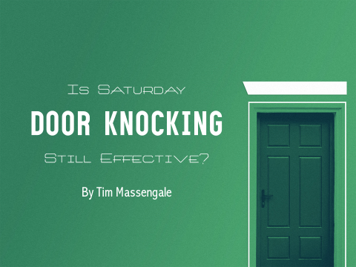
Is Saturday
Door Knocking
Still Effective?
By Tim Massengale

Slide 2
For years, door knocking was about the only type of consistent outreach.
Outreach" and "door knocking" were pretty much synonymous terms: where you found the one, you would normally find the other.
Today, except for a handful of die-hard adherents, few churches walk the neighborhoods and ring the doorbells.

Slide 3
Several new approaches have given greater effectiveness to this type of ministry, bringing a reevaluation in the hearts of many.
Perhaps this is because such a heavy emphasis has been placed here in the past. Or maybe it's because that's what Mom and Dad always did.
But whatever the reason, the doorbells are ringing again and the churches doing so are singing it's praises as new contacts are being made and home Bible studies are being set up..

Slide 4
What has brought about this change? Simply this: A realization that for any outreach to be effective, it must meet people's needs.
To go up to someone's door and invite them to church is fine – but let’s face it, seldom do they ever come. The entire sequence says, "I want you to do something for me - come to my church".
Unfortunately we live in a very "me" oriented generation. The world's view of everything today seems to say "what's in it for me? What will I get out of it?"

Slide 5
The change in approach has been to offer a needed service, to give them something they want:
Personal Bible course (Home Bible Study)
Belonging to a Sunday School (Sunday School Enroll-to-Grow)
Bible Education for their children (Bus Ministry)
Ride for those lacking transportation (Car Ministry)
Social/educational program for youth (Youth Ministry)
Enjoyable activity (church drama, musical, program)

Slide 6
Developing the Ministry
First, place "Saturday Door Knocking" on your annual outreach commitment form (if you don’t have an annual outreach commitment service, preach a sermon on the need to reach the lost and ask all who are willing to participate in door knocking to sign a list).
Explain that those who commit to involvement that they will only be going out one Saturday per month.

Slide 7
Once people have committed to involvement, draw up a six-month schedule of what Saturdays will be used for this ministry.
Post the schedule and give a copy to each person involved. This will help them plan on being there.
Announce the intended Saturday the Sunday and Bible study night before going. Put a notice in the church bulletin if you have one.

Slide 8
Also the director of this ministry must call all team members the Thursday or Friday before going out and get a verbal commitment from each to be there Saturday morning.
This is a MUST! Since they don't go out every week, and it's not always on the same Saturday of the month, people tend to forget.
The door knocking team should meet at the church Saturday morning at about 9:30 a.m. After a short time of prayer, they hit the streets and knock on doors until noon.

Slide 9
They then return to the church for a group lunch (brown-bag or potluck style).
After lunch, the director should give the group a quick "pep talk.“
Have testimonies from those that have had success. This will inspire those who may have had a bad morning. The team may then goes out for another hour or two following lunch.

Slide 10
Plan to Use a Variety of Methods in Door Knocking
Get home Bible Studies with the Quest Survey
Enroll Sunday School Members with Enroll-to-Grow
Get Kids for your Bus, Van, or Car Ministry
Offer a ride Sunday morning to those lacking transportation
Sign-up kids for Boy’s and Girl’s Scouts or Kids Clubs
Flyer & ticket distribution for special events

Slide 11
Several Keys to Success:
Select well in advance what method to use.
Start your team in lower class neighborhoods.
Divide groups into smaller teams and have friendly competition.
Encourage those who feel they cannot knock on doors to pray for those who do.
Be consistent.

Slide 12
Once a quarter, invite the whole church out for a special “big” push.
Don’t pair-up people who participate.
Areas knocked should be placed on a map so the teams don’t overlap them.

Slide 13
In Conclusion
D.L. Moody: “I would rather train ten soul winners than win ten souls.”
The key to effective personal evangelism and outreach is for a pastor to reproduce his burden and ability into the hearts of his people.
A pastor cannot allow occasional poor participation to discourage him in consistently sowing the seed of the Word of God.

Slide 14
A visiting pastor is once to have said to his fellow pastor after the announced visitation was poorly attended, “Isn't it terrible that so few come out for Saturday Door Knocking? This is why I don't even do it!”
To which the pastor replied, “Poor as it is, I like the way we do something better than the way you do nothing!”
May God bless you with an abundance of harvest and a growing church!

