Slide 1
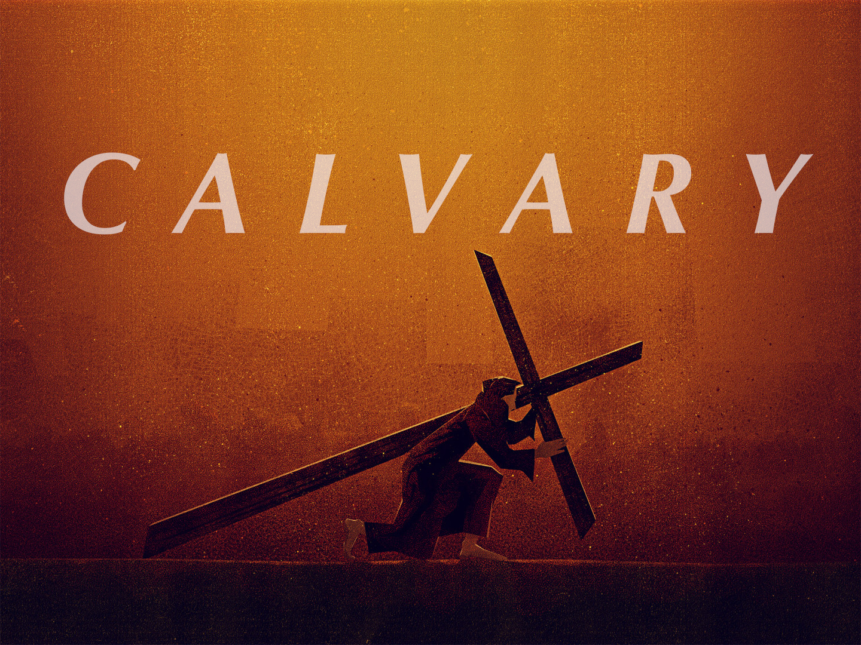

Slide 2
The Scourging:
Scourging was the ordinary preliminary to crucifixion.
It was a punishment so truly horrible that the mind revolts at it
The sufferer was publicly stripped, tied by the hands a bet in position to a stake, and then, on the tense quivering nerves of the naked back, the blows were inflicted with a leathery thong, weighted with jagged edges of bone and lead

Slide 3
The Scourging:
Each stroke cut into the quivering flesh, until the veins were laid bare
Often the scourge struck the face and knocked out the eyes and teeth
The victim generally fainted and often died
When we study the awfulness of the Roman scourging, Peter's statement, "by whose stripes ye were healed" (I Peter 2:24) will have new meaning

Slide 4
The Scourging:
Instead of feeling pity for Jesus, the brutal soldiers dragged Him to the courtyard to make sport of Him
Their brutality was simply a savage delight in torturing
Over His lacerated body, they cast a purple robe, and pressed down on His head a plaited crown of thorns

Slide 5
The Scourging:
In His right hand, they placed a reed for a scepter, and then made Him the subject of jesting, striking Him insultingly with rods on His thorn-crowned head
Bowing before Him they mockingly cried, "Hail, King of the Jews"
Their actions were prophetical
He who wore the crown of thorns shall be King; He who held the reed shall exercise world dominion; one day every knee shall bow before Him whom they mocked

Slide 6
Bearing the Cross:
Condemned persons were required to carry their own crosses to the place of execution
They placed the cross upon Jesus, but weak and exhausted He fell under it
The soldiers than forced a Jew of Cyrene, Simon, to carry the cross
Simon was the father of Alexander and Rufus
Because of the place that these sons took in church history, it is thought that Simon came to the personal knowledge of a Savior

Slide 7
Bearing the Cross:
On the way to the place of execution some women broke out into lamentations and bewailed His sad end
Jesus turned to them and told them not to weep for Him, but rather weep for themselves
He gave them warning of the destruction that would come within a generation in 70 AD

Slide 8
Bearing the Cross:
When He reached Calvary He was offered a drink to ease His sufferings
Women who had compassion upon those being executed prepared this
This drink consisted of wine mixed with narcotics.
Our Lord refused this drink for He would not suffer death for the world with a mind beclouded with drugs

Slide 9
Calvary:
The word "Calvary" is derived from the Latin and means a “skull"
It corresponds to the Aramaic word "Golgotha"
It was a place of execution and was located outside the gate of the city
It may have received its name because of its appearance; a bare, round, scalp like elevation

Slide 10
Crucifixion:
The cross was the most disgraceful and one of the cruelest instruments of death ever invented
The Jews never used it as a means of execution
The Romans would not allow Roman citizens to be crucified, but they reserved crucifixion for slaves and foreigners
It was the death of the most extreme anguish

Slide 11
Crucifixion:
The victim was first stripped naked
Then the victim was laid down with arms extended on the crossbar
A large iron nail was driven through the center of each open palm
Then the transom was raised to its position on the upright and nailed securely

Slide 12
Crucifixion:
Following this the feet were nailed either through the instep separately, or both together with a single iron peg
There the body was left to hang supported on four great wounds
The body was left to hand sometimes two or three days until death took place

Slide 13
Crucifixion:
Death by crucifixion included all that pain and death can bring about including cramps, thirst, starvation, sleeplessness, fever, tetanus, shame, torment
As time passes the torture and suffering grew more and more unbearable until the victims would plead to be put to death
Constantine abolished death by crucifixion

Slide 14
Christ on the Cross:
Jesus was nailed to the cross at the third hour or nine o'clock in the morning
He died at three o'clock in the afternoon
Among other prophecies that were fulfilled at Calvary were:
Psalm 22:16-18 - The soldiers cast lots for the Lord's garment because it was in one piece
Isaiah 53:12 - "he was numbered with the transgressors" A thief was crucified on each side of Jesus

Slide 15
Christ on the Cross:
At the foot of the cross stood a small band of faithful followers who showed courage and devotion
The party consisted of five: Mary, mother of Jesus, Salome, Mary, the wife of Clophas, Mary of Magdala and John
Since the day was a feast day, the Jews asked that their legs would be broken in order to hasten death and that their bodies be taken from the cross

Slide 16
Christ on the Cross:
When the soldiers came to Jesus Christ they found that He was already dead.
Therefore they did not break His legs, again fulfilling Old Testament prophecy.
One of the soldiers to make certain that He was dead pierced His side with a spear and from His side came water and blood.

Slide 17
Christ on the Cross:
It is claimed that blood and water coming from the body is evidence of a broken heart
Since Jesus died in six hours we may conclude that His death was due not to physical sufferings but to spiritual anguish

Slide 18
The Miracles of the Cross:
1. DARKNESS:
It was noon and the brightest moment of the day
Suddenly darkness fell like a heavy curtain over the scene of tragedy
This darkness was not due to an eclipse because it was

Slide 19
The Miracles of the Cross:
The time of the full moon of the Passover
It was a supernatural act of God, a miracle
It seemed that the sun could not look upon the horrors of that scene

Slide 20
The Miracles of the Cross:
2. RENDING OF THE VEIL IN THE TEMPLE:
This veil was the thickness of a pal breadth, sixty feet long and thirty broad, and woven of tough fabric
It separated the Holy and Most Holy Places in the Temple

Slide 21
The Miracles of the Cross:
This was a miracle for there can be no explanation how this could have happened
The veil was rent "from top to bottom" by God's hand, thus throwing open the Most Holy Place to all men

Slide 22
The Miracles of the Cross:
3. EARTHQUAKE:
The earthquake that took place was supernatural
The rocks were rent and tombs were shaken open

Slide 23
The Miracles of the Cross:
After His resurrection three days later, some of the Old Testament saints were raised and appeared to the disciples
The Centurion who had charge of the soldiers witnessed the earthquake and the darkness, cried out: "Truly this was the Son of God"

