Slide 1
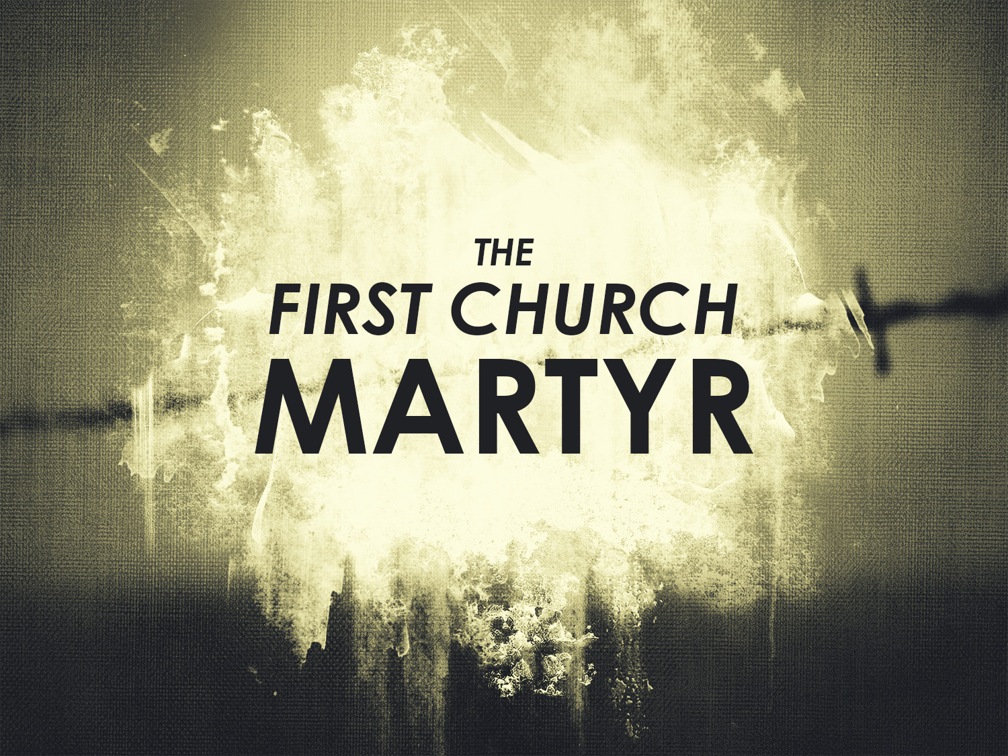

Slide 2
STEPHEN, THE FIRST CHURCH MARTYR:
Stephen was a Grecian Jew and one of the first seven deacons
He is described as being full of faith and power (Acts 6:8)
He preached under such anointing that none could resist the wisdom and the spirit by which he spoke
Great wonders and miracles followed his ministry
His name means, “crown"
His name certainly was appropriate for he was the first to wear the martyr's crown

Slide 3
THE SYNAGOGUES IN JERUSALEM:
The Hellenistic Jews who had returned to Jerusalem to live had established at least five synagogues in Jerusalem
The Jews who assembled in this synagogue were Jews who had been taken prisoners by Roman generals, reduced to slavery, and then later emancipated and returned to their homeland

Slide 4
THE SYNAGOGUES IN JERUSALEM:
Since Stephen was a Grecian it was natural for him to go to the Grecians with the gospel message
Stephen preached with wisdom and power
This made them very angry and they determined to get rid of this Holy Ghost preacher
Therefore they suborned men (hired men to give false witness) who accused him of speaking blasphemous words against God and against Moses (Acts 6:11)

Slide 5
THE SANHEDRIN:
Stephen was taken before the council (Acts 6:12), which is the Sanhedrin
This was the supreme council of the Jewish people
It had its origin with the seventy elders Moses appointed to have help him govern Israel
At this particular time it was to have seventy-one members – seventy plus the president

Slide 6
THE CHARGE AGAINST STEPHEN:
The charge that the false witnesses made against Stephen was twofold:
  (1) Stephen was speaking against the temple
  (2) He was changing the Law of Moses
The charge also accused him of being a blasphemer

Slide 7
THE SERMON OF STEPHEN:
Stephen's sermon is the longest sermon recorded in the book of Acts
He begins the sermon with a simple salutation and he immediately begins an accusation of the Jewish leaders themselvesHe becomes their judge passing sentence upon them

Slide 8
THE SERMON OF STEPHEN:
Stephen in his sermon dwells in detail upon the past history of Israel
He proves that they ever rejected God's grace while failing to obey God's law
Stephen charges the Sanhedrin with high treason against God

Slide 9
THE Stoning OF STEPHEN:
As the members of the council listened to Stephen they were convicted deeply
They grew so angry that they rushed upon him, cast him out of the city and stoned him

Slide 10
THE Stoning OF STEPHEN:
The Sanhedrin had no power to sentence anyone to death but they ignored this because of their anger and hatred
Among the council was Saul of Tarsus
He consented to Stephen's death (Acts 8:1)
By this statement we know that he approved of and was pleased with Stephen's death

Slide 11
STEPHEN'S VISION:
Stephen called upon God, saying, "Lord Jesus, receive my spirit." Therefore, when Stephen saw God, he knew that He was Jesus Christ
The expression "on the right hand of God" simply means the place of power and glory. There are many passages of Scripture, which bring this out clearly. "And Jesus said, I am: and ye shall see the Son of man sitting on the right hand of power." (Mark 14:62)
In many of the Scriptures where it describes Jesus as being in the place of power and glory, it describes him as sitting. However, in Acts 7:56 Stephen saw him standing. Could it be that Jesus arose to welcome the first martyr?

Slide 12
STEPHEN'S VISION:
Consider some similarity between the martyrdom of Stephen and the death of our Lord
  1. In both cases the people were stirred up
  2. Stephen was cast out of the city; Jesus was led out to be crucified
  3. Both prayed for their murderers
  4. Both committed themselves to God
  5. Both cried with a loud voice. In both cases this was a cry of victory

Slide 13
TWO FINAL TRUTHS:
Finally, there are two things that the student's attention should be drawn to:
  1. The manner of Stephen's death: "fell asleep" (verse 60) speaks of a quiet peaceful death

Slide 14
TWO FINAL TRUTHS:
The second thing that the student's attention should be drawn to:
  2. The effect of Stephen's death upon Saul: Saul of Tarsus was never the same man after this scene
  Although he did his best to drown out conviction by leading a persecution against the church, we are confident that he remembered this scene for his entire life and many times later became a great source of strength and courage to him

