Slide 1
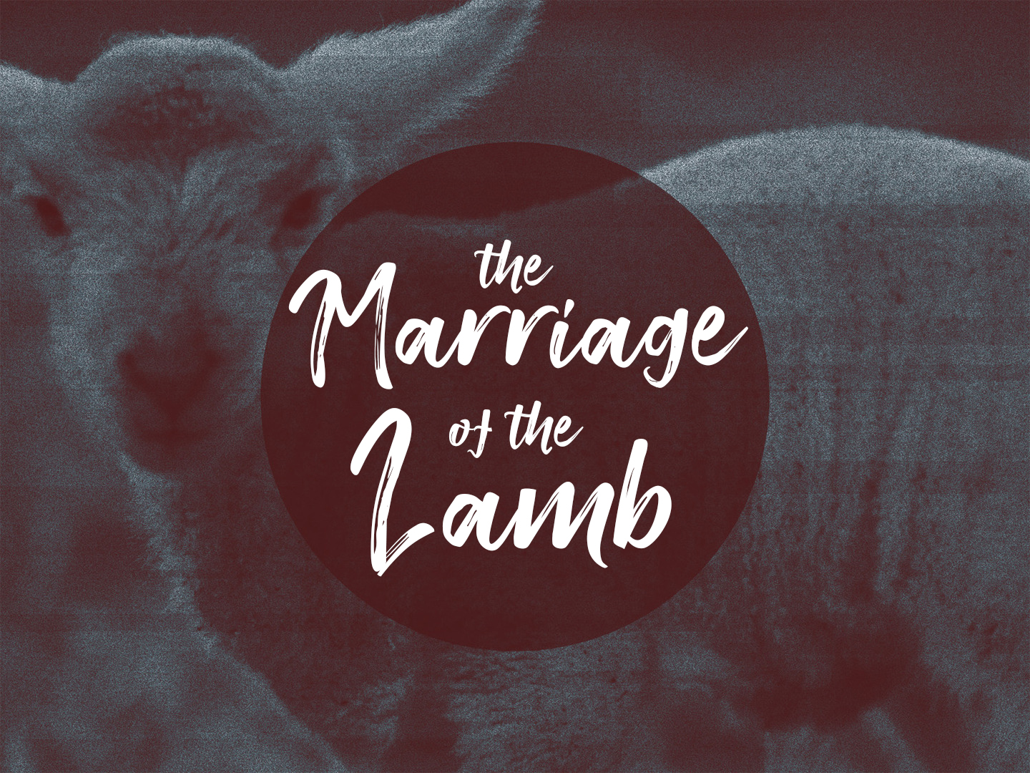

Slide 2
The Importance Of The Marriage
This may be understood when we remember that it was ordained before the foundation of the world
This great event is the crowning climax to the eternal purpose of God
That He might present to Himself a glorious church that is His sweetheart, His bride

Slide 3
The Hallelujah Chorus
The word "Hallelujah" comes from a Hebrew word meaning, "Praise ye Jehovah"
  It is the cry of victory over the enemies of the Lord and gives praise to the Lord

Slide 4
The Hallelujah Chorus
The second cause for the rejoicing was that "The Lord reigneth"
  The saints had been praying for centuries "Thy Kingdom come"
The third reason for the Hallelujah chorus is stated in verse seven. "The marriage of the Lamb is come"

Slide 5
The Marriage of The Lamb
WHO IS THE BRIDEGROOM?
  The Lamb is the bridegroom
WHO IS THE BRIDE?
  The bride is certainly the blood bought, blood washed, Spirit-filled church that bears the Name of Jesus

Slide 6
The Marriage of The Lamb
WHO ARE THE GUESTS?
  The guests are the Old Testament saints and the Tribulation saints
WHERE DOES THE MARRIAGE TAKE PLACE?
  New Jerusalem, the city foursquare
  When the church is raptured she is brought into the presence of God before His throne

Slide 7
The Marriage of The Lamb
WHEN WILL THE MARRIAGE TAKE PLACE?
  After the church is raptured while the Tribulation is upon earth, she will appear before the judgment seat of Christ
  The marriage will take place just before Christ returns to earth to reign in His millennial Kingdom

Slide 8
The Marriage of The Lamb
HOW DID THE BRIDE MAKE HERSELF READY?
  The preparatory work of getting ready for the wedding goes on continually from the moment the Christian is born again
WHAT IS HER WEDDING DRESS?
  Her wedding dress is described as being fine linen, clean and white

Slide 9
The Marriage Supper
The marriage super takes place after the wedding
All guests are invited guests
They are blessed to be invited to such a happy and wonderful event

Slide 10
Who Gets The Glory?
Revelation 19:7
The bride is the one who attracts the most attention at all weddings
All the pageantry is there to give honor to the groom who receives his beautiful bride
The bride was chosen to the praise of his glory (Ephesians 1:12)

