Slide 1
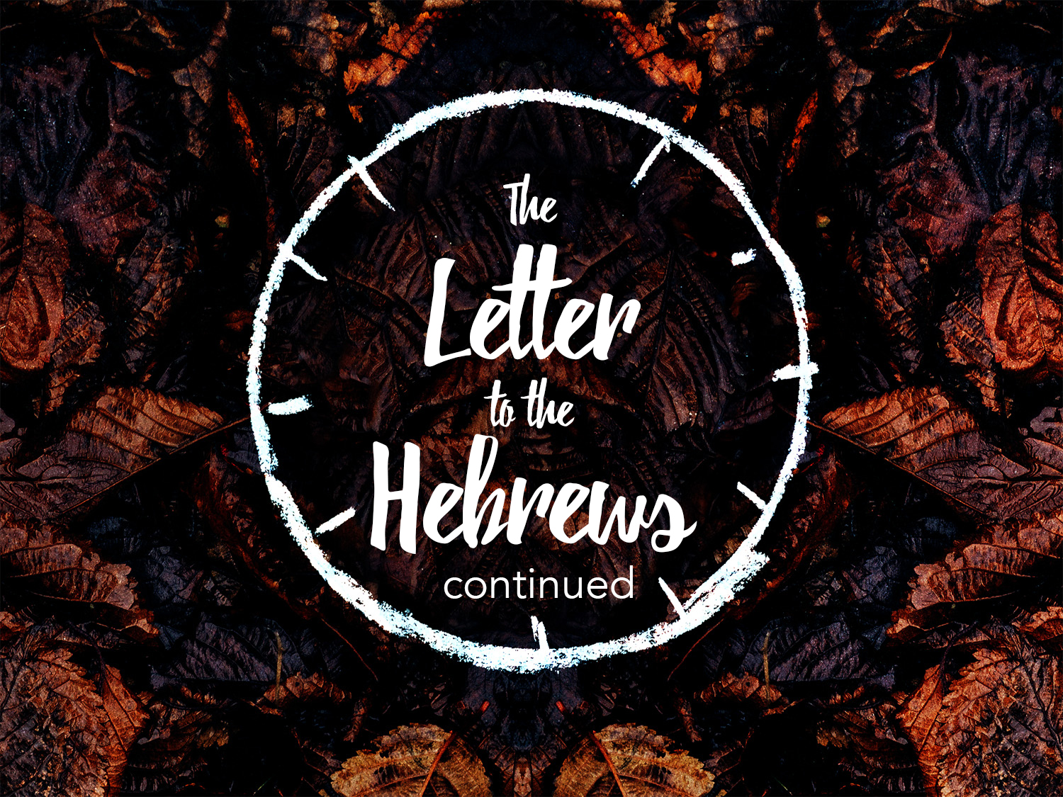

Slide 2
A Solemn Warning Against Neglect
There is no escape if this great salvation is neglected
  Neglect could mean failing to give attention to prayer, Bible study, church attendance, etc.
  It could also mean becoming careless because of the love of this world

Slide 3
A Solemn Warning Against Neglect
This salvation is not only great, but it is "SO" great
Why is it so great?
  It is the only salvation
  The price that was paid for it makes it great
  It embraces the whole world

Slide 4
A Solemn Warning Against Neglect
  It saves to the uttermost
  There is power to save all men no matter how deep in sin they may have fallen
We had better not drift away from the gospel spoken, for if we neglect it, we are lost and certain judgment awaits us

Slide 5
The Humanity Of Christ
Christ became the Son of Man that men might become the Sons of God
He came to redeem man and was made in the likeness of man
As a man He lived, as a man He died and as a man He is our mediator (I Timothy 2:5)

Slide 6
More Worthy Than Moses
Hebrews 3:1-6
Here Paul shows the superiority of Christ over Moses
The Hebrews were requested to consider Jesus who is the Apostle and High Priest of our profession

Slide 7
More Worthy Than Moses
Moses was considered the savior and leader of Israel and as such he had been the apostle of God to the Israelites
Next in importance was their high priest, Aaron, who acted as mediator between them and God

