Slide 1
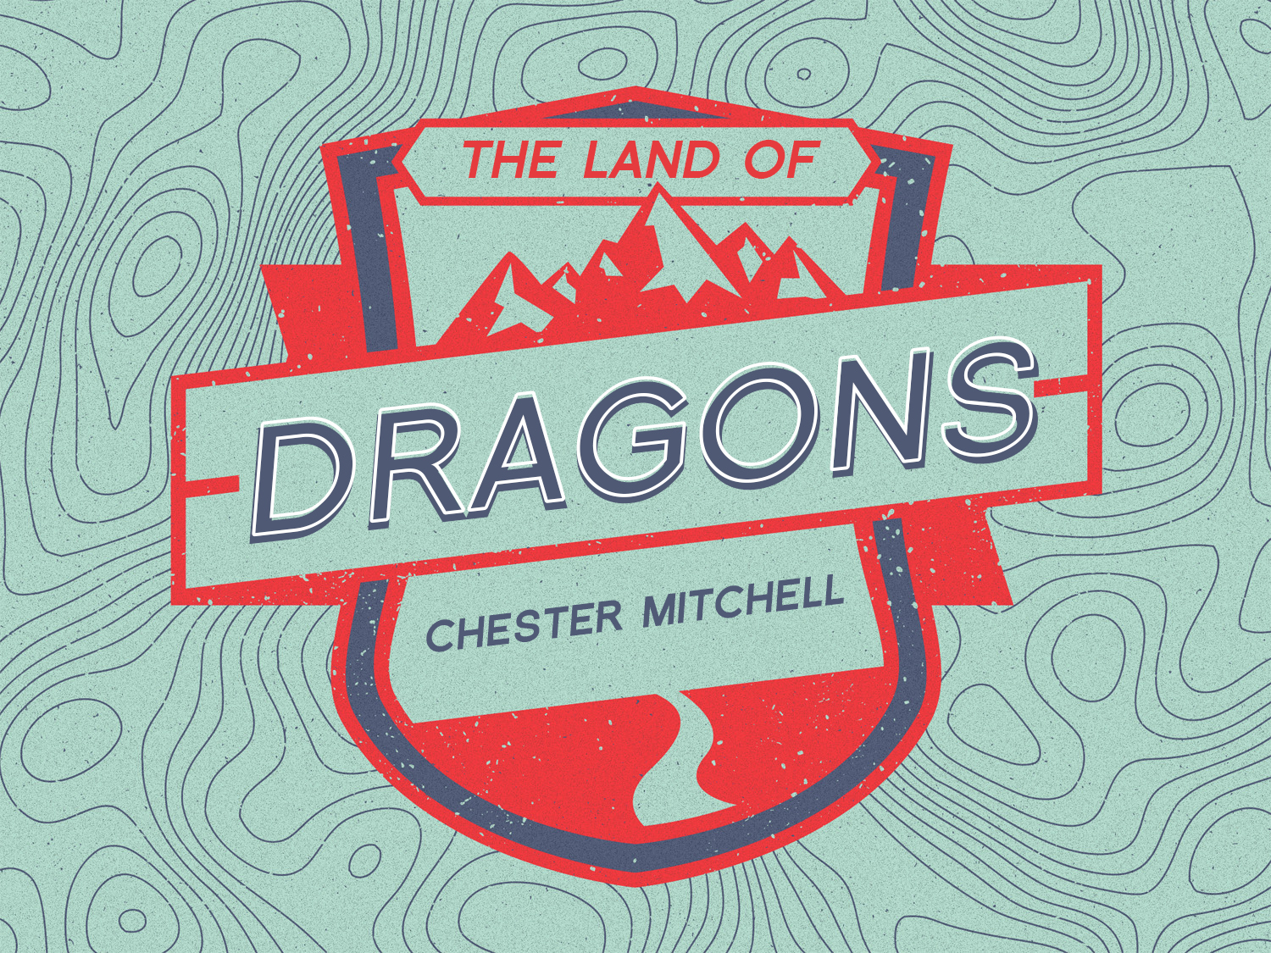

Slide 2
Introduction
Hebrews 11:15-16
Christopher Columbus wrote in a map's margins, “Here lie dragons and wild beasts”
Walking with God isn't solely about certainty- it involves uncertainty the people of the Bible whom we call "heroes" weren't certain of everything
They were certain about God's character, God’s commitment to His Word, and His power
Once those things were established, they allowed God to chart a course for their lives—a journey into the unknown

Slide 3
Mary, the Mother of Jesus
Mary was ordinary—nothing about her would have set her apart from the thousands of virgin girls in her community
  What made her special was the fact that God invited her to play a role in the revelation of his greatest gift to the world
  Ordinary is the vessel into which God most often pours His greatest power
  Consider the words of 1 Corinthians1:26-29

Slide 4
Walking With God
The varied characters of the Bible were different from each other, but one thing bound them together: None of them allowed their relationship with God and, ultimately, their "divine assignment" to go unfulfilled because they lacked the facts
Walking with God isn't about having all the facts
Noah wasn't certain that the big boat would work
  His confidence was anchored in nothing more than the Word of a God he had never seen, as shown in Hebrews (Hebrews 11: 7)

Slide 5
Walking With God
And Abraham had no map of the promised land, but he walked out of Ur of the Chaldees based simply on what God had told him (Hebrews 11:8)
Joseph was uncertain what would become of his dream, but God’s blessing upon Joseph's life spilled over, and the household of Potiphar was blessed because of Joseph
  And later Joseph traded in the prison robe for the Prime Minister's robe
Just because God hasn't shown you everything doesn't mean that you've missed God's will

Slide 6
Matthew, the Tax Collector
Walking with God and uncertainty go hand in hand
If you have any doubts, just ask Matthew, he was as the "numbers guy" among the twelve disciples Jesus chose
For tax collectors, it all came down to calculating the numbers—nothing was left to feelings or faith
He was sitting in the tax office when "the carpenter" came calling and, with him, great uncertainty
Matthew 11:1-11

Slide 7
Surrender
Walking with God is about surrender. Paul implored the Christians in Rome to "present your bodies a living sacrifice" (Romans 12:1-2)
Walking with God is about losing your life, it is about dying to self
When Columbus set sail, there were those who doubted that he would come back
  They believed that the maps were correct; at the edge of the "known" was the place of dragons, but Columbus refused to believe the “experts”
  And ultimately, he sailed beyond the maps and changed history

Slide 8
Surrender
Sometimes in walking with God, you have to lay everything on the line and trust the still, small voice of the Spirit
John 3:8

Slide 9
Outside of the Comfort Zones
During my years of walking with God, I've noticed that the people who are fearful of walking with God outside their comfort zones often spend their days in their comfortable place inventing mythical "dragons" that become larger and larger as time passes
You're free only when you embrace God's truth John 8:32

Slide 10
Outside of the Comfort Zones
When Columbus returned, the coins of Spain were re-minted
  The old inscription, "No more beyond," was replaced with "More beyond!”
  God's challenge to you and me is to deal with the "dragons" just as Columbus did. You might be dealing with fear, regret, a failed marriage, or an addiction—whatever the dragon, focus your vision on Jesus Christ and move in spite of uncertainty. More Beyond!=

Slide 11
A Step on the Journey:
Defeating the Dragons:
  Fear (2 Timothy 1:7)
  Low Self-Esteem (Ephesians 2:10)
  Addiction (Luke 4:19)
  Spiritual Exhaustion (Matthew 11:28-30)

