Slide 1
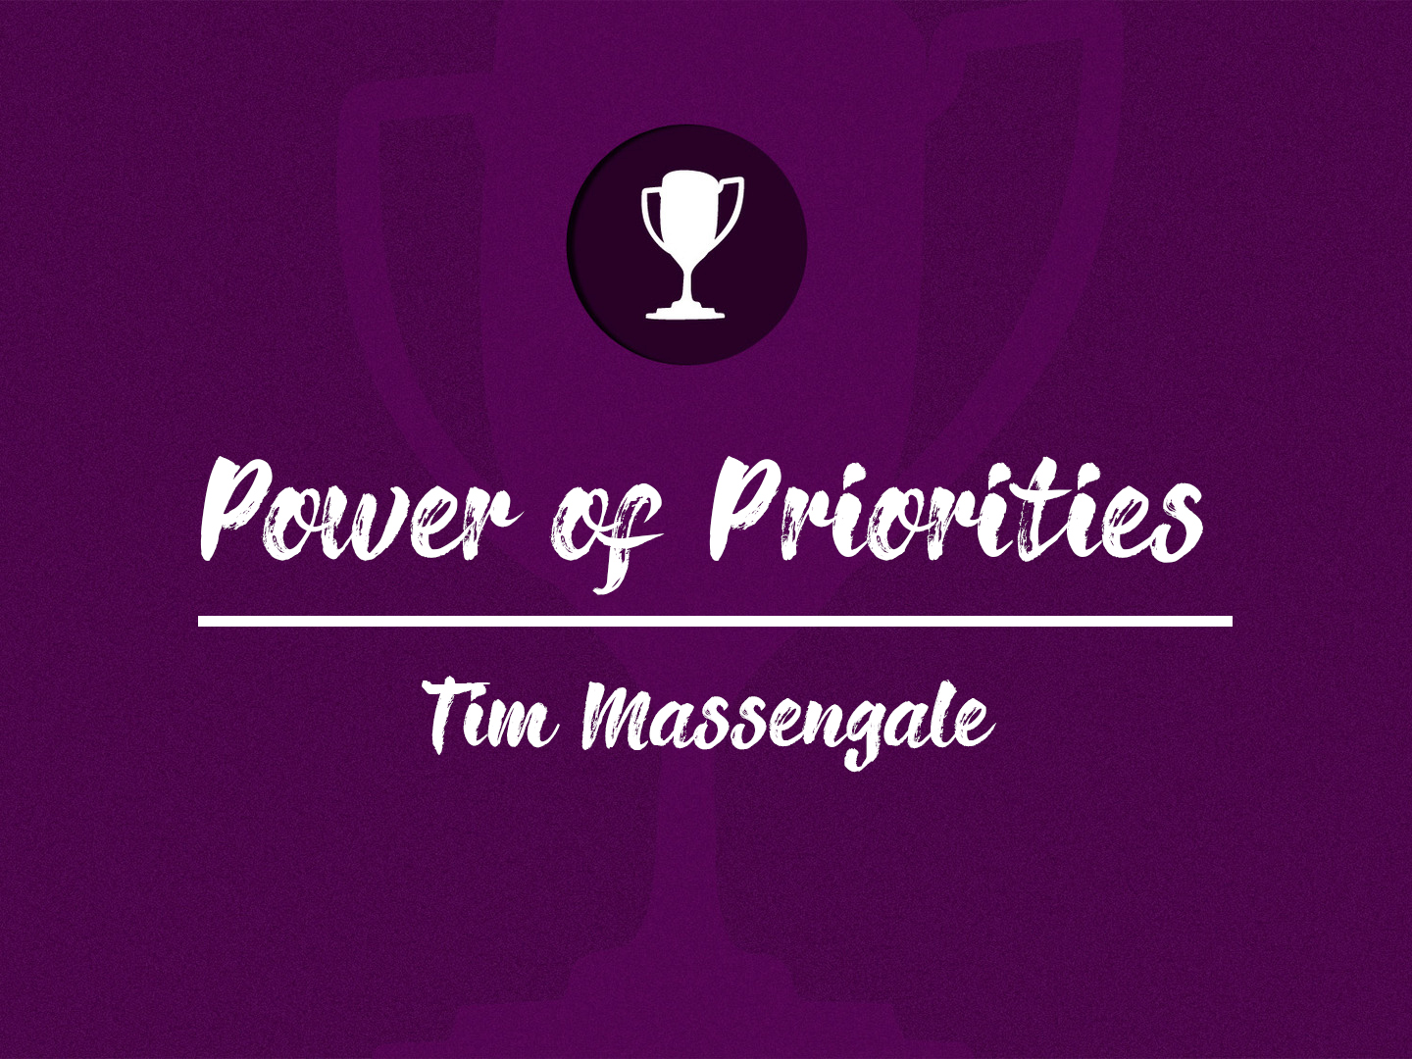

Slide 2
Introduction
Charles Schwab, president of Bethlehem Steel Company, granted an interview to an efficiency expert named Ivy Lee
During said interview Mr. Lee said he could give something that would increase Mr. Schwab’s achievements by 50%
Mr. Lee continued and told Mr. Schwab to write down six important things he needed to get done, he then told him to leave it on his desk, look at it first thing in the morning, and start with number one and go down the list until it was closing time

Slide 3
The Order of Importance
The concept of taking projects one at a time, in their proper order of priority is an idea that can turn the ideas of your evangelism planning retreat from dreams into reality
This concept must not only be applied to implementing new ministries and programs, but also to solving problems and weaknesses
The problems that you are facing with your church, you can deal with them one at a time, and you can win

Slide 4
The Departmental One-Year Plan
The idea of having an evangelism planning retreat with your leaders once a year to plan your annual evangelism strategy, is a powerful tool
When you return from your retreat make sure to space out the dozen or so ideas your leaders want to put into action, if you don’t it can bring confusion, not growth

Slide 5
The Departmental One-Year Plan
Have your various leaders set priorities as to what should come first, each plan should be fully planned and implemented in a systematic fashion
  The next idea or project should not be begin until the current one is completed

Slide 6
Developing Your One-Year Plans
At your Evangelism Planning Retreat, you should encourage your directors to take detailed notes as their department is discussing what they need or wish to do and when they are going to do it
Request that each director hand in a written one-year plan of their departmental plans and activities containing three parts:

Slide 7
Developing Your One-Year Plans
  Numerical Goals - number-type goals that the department might have
  Quality Improvement Goals - any projects to improve the quality or program of the department
  Department Activities - all annual department activities – events that happen every year, rain or shine

Slide 8
Important Considerations
Give yourself plenty of time to complete goal or task
The quality improvement goals should be in priority order, the most important ones first
Stay flexible – it is important that your leaders realize that plans and dates are not chiseled in stone, things can change
Evaluate regularly, the idea of flexibility is that of evaluation corrections are often necessary and might include changes in personnel, finance, or dates

Slide 9
Conclusion
Department leaders are sincere in their desire to work for God, but few know how to plan effectively; they work in spurts, become bogged down and discouraged, and often quit altogether
We can make a difference, but only if we work together, not against one another
It is vital that all plans, projects, and ideas for improvement be coordinated together toward the ultimate goal of winning the lost with The Departmental One-Year Plan

