Slide 1
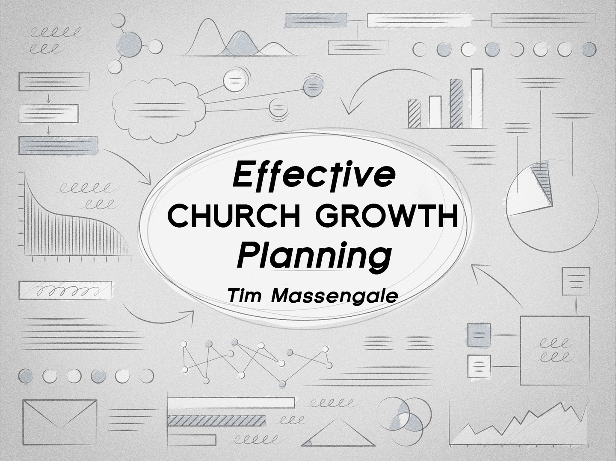

Slide 2
Henry Ford
Most people credit Henry Ford with inventing the automobile, the truth is he didn’t
Although he held many patents on various automotive mechanisms, the invention of the first self-powered carriage is credited to Nicolas Cugnot of France in 1771
But history does credit Henry Ford with being a master of effective planning
  His assembly-line production completely revolutionized the auto industry by greatly reducing the time required to assemble a car
  He decided to pass on this savings to his customers, and in 1915 dropped the price of the Model T from $850 to $290

Slide 3
Henry Ford
    That year alone he sold 1 million cars and soon after became one of the wealthiest men in the country
    Thomas Edison, who painstakingly worked to produce the first successful incandescent light bulb also believed in effective planning
      He said, “Good fortune is what happens when opportunity meets with good planning.”

Slide 4
Planning Effectively
One of the biggest secrets of successful church growth lies in the ability of a pastor to plan effectively with his ministry leaders
Two simple, but important aspects of effective church growth planning:
  First, schedule an Annual Planning Retreat
    Get away at least once a year with your key ministry leaders for an over-night, idea-intensive brainstorming session to solve problems and plan the coming year

Slide 5
Planning Effectively
  Second, ask each ministry leader to hand in a Departmental One-year Plan
    This is a simple written outline of their departmental plans and goals for the coming year
  The Monthly Planning Council
    It provides the means of accomplishing one of the most common weaknesses in church planning: the tendency to not follow-through once plans have been made
Ecclesiastes 4:9, 12

Slide 6
How Often Should You Meet
In sports we see many examples of the need to plan
A game plan is simply a series of steps which the team must follow in order to accomplish its goal of winning the game
How often should a pastor plan with his ministry leadership?
  If a church is large enough to have several full-time individuals such as secretaries, assistants, youth director, music director, and so on, a pastor often meets weekly to organize the weeks activities

Slide 7
How Often Should You Meet
  The majority, probably over 90%, are fortunate if the pastor himself is full time, so a pastor will be planning with a volunteer staff of department heads
  Some pastors have tried to have departmental meetings only once per quarter
    Meetings are too long because too much is happening, and because of limited time, little or no actual planning is done and the meeting becomes nothing more then a calendar making session
  The best and most successful approach has been the Monthly Planning Council
    This once per month meeting is utilized for training, reporting, planning, and brainstorming on all facets of the church

Slide 8
Who Should Come
The Monthly Council is attended by all primary department heads
This could be as many as twelve individuals
  This would include Sunday School, Outreach, Ladies Ministries, Music, Youth, New Convert Care, Men’s Ministry, Home Bible Study, Visitor Follow-up, Bus Ministry, and so on
Spouses are not required to come, although if they wish to attend, they may
The more people there are, the longer the discussion tends to be, and the greater difficulty you will have in arriving at any group agreement

Slide 9
Monthly Council Success
In the corporate world, business meetings are an important component of success
Entire books are devoted to this subject
First, be sure to provide a typed agenda at each meeting
  Each department should be listed and the topics of discussion should be listed
The Monthly Council is usually held at the church
Occasionally it is nice to meet at a restaurant (in a private area) or in a home
  This adds a different atmosphere that will break up the "rut" that can sometimes develop

Slide 10
Monthly Council Success
  Discipline yourself to push the meeting to a specified time conclusion.
  As you come to each department, the pastor should have the director quickly read his or her monthly report- the results, not the full report
  As each agenda topic discussed, detailed planning should be done- you should ask the director questions
  At the end of the meeting, the pastor (or secretary) should quickly read over the notes of the meeting to emphasize "what has been accomplished”

Slide 11
Monthly Council Success
  By doing this, it accents the importance of the Monthly Council and underscores that their time that night has been well spent
  The growth and success of your departments, as well as your church, will be determined by the effectiveness of these monthly councils

Slide 12
In Conclusion
  Solomon, a man truly blessed with wisdom, wrote "Where no counsel is, the people fall; but in the multitude of counselors there is safety" (Proverbs 11:14, NIV)
  He again wrote, "Without counsel, purposes are disappointed: but in the multitude of counselors they are established" (Proverbs 20:18, NIV)
  It was by failing to listen to his counselors - and instead, listening to his heathen wives - that led Solomon to his own downfall
  By bringing the key leaders together, a pastor builds a team spirit into his directors
  And by helping his directors solve their problems, the pastor motivates them to accomplish more, and thereby see more souls born into the Kingdom of God

