Slide 1
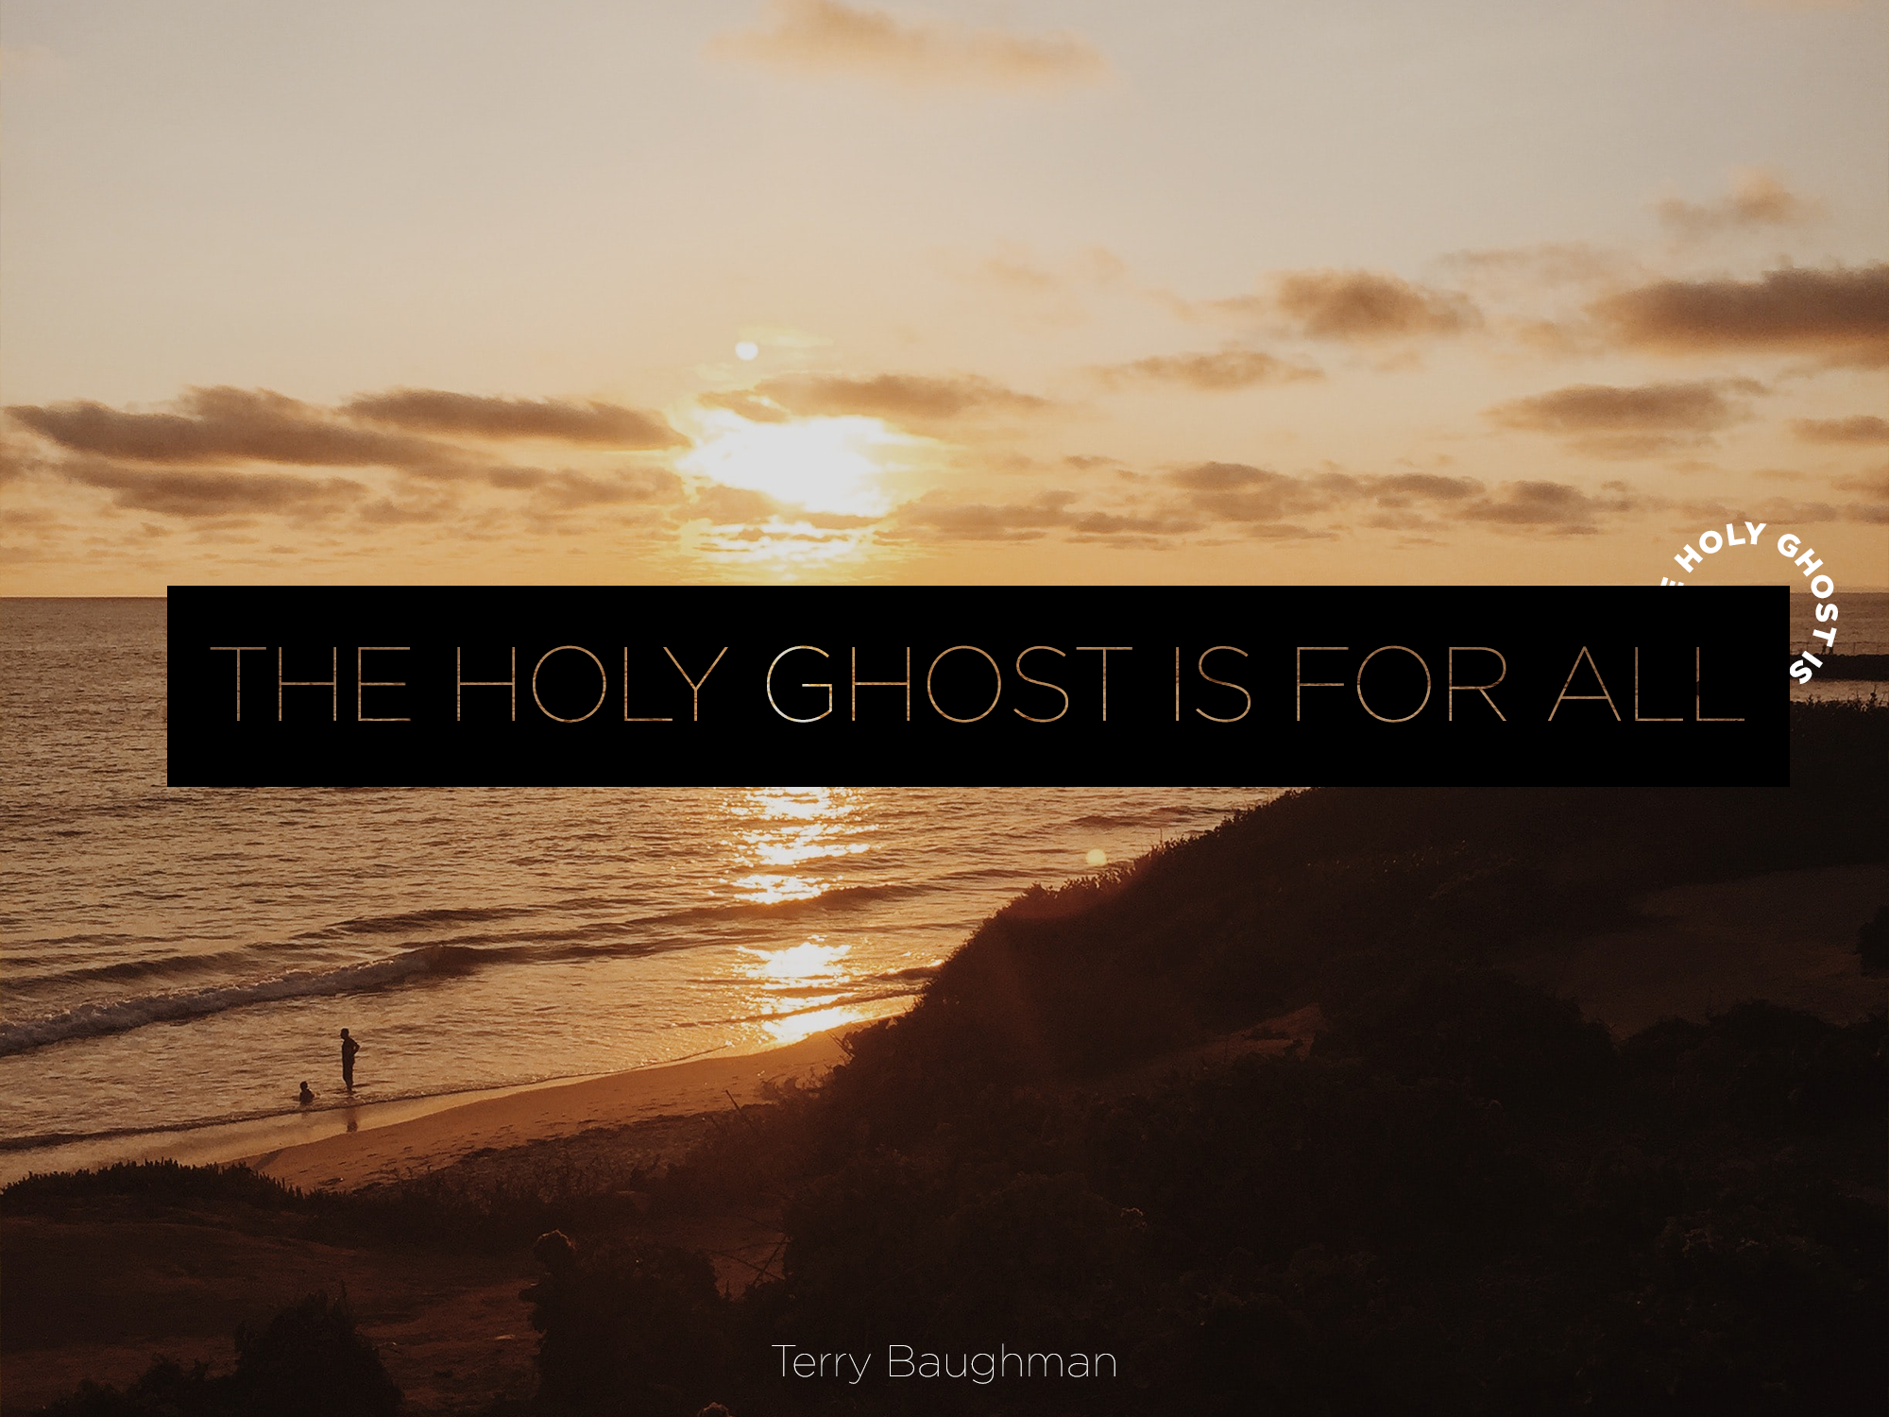

Slide 2
Joel 2:28-29
  When he said all flesh he didn't leave out any color.
  He didn't leave out any tongue or nation.

Slide 3
Various nationalities of people were filled with the Holy Ghost
  Occasion was the Day of Pentecost; this chapter records the outpouring of the Spirit and the beginning of the New Testament church.
  This is where it all began. This was the first order of business in the New Testament church!

Slide 4
In the initial business meeting
Cloven tongues as of fire sat upon each of them and they began to speak with other tongues as the Spirit gave them the utterance.

Slide 5
Acts 2:17, this prophecy of Joel was quoted.
  There are those today who believe that only the twelve apostles received the Holy Ghost like this.
  But God promised to pour out his spirit on ALL flesh, not just the twelve.
  Some strange ideas are devised when people ignore the Scriptures concerning the baptism of the Holy Ghost, the New Testament church, and the deity of Jesus Christ and his fullness.
  Many reject the events of the book of Acts as relevant to our day and they refuse to preach the message that Peter preached.

Slide 6
It is my intention to preach the message right as it is written.
  We are going to preach and believe the message just like we have received it. This message is a promise for all flesh!
A personal experience of the promises of Scripture is the greatest evidence that the Bible is true. God has given me what the Bible said I could have.
  Ezekiel 36:26-27
  In Revelation 22:14

Slide 7
Jeremiah 31:31-33
  Through the prophet Jeremiah God said that he would make a different covenant with Israel and Judah.
  They broke the original covenant and they were judged in the exile. But God said he would make a new covenant with them.
  He will not just write the laws on the wall or on a stone like the Ten Commandments, but he will make another covenant written in the heart.

Slide 8
You can become a part of the people of God through a born again experience.
  You don't join this group just by signing a card.
  You don't become a part of this church just because you feel sorry for your sins.
  You don't become a member because you shed tears.
  You get into it by birth. You are born into it.

Slide 9
God will allow you to use the talents that you have been given.
  If you have more ability, you may have been given five talents. He will let you use them.
  If I only have one talent, I want to add to that one. I don't want to dig a hole in the ground and bury it. That's bad digging!
  To the one who failed to use his talent God said, “Depart from me." God rejected the man that took his single talent and buried it.

Slide 10
The river flowed under the tree where Zacchaeus was waiting to see Jesus come by.
  Jesus invited him down from his perch and said I'm going to come to your house today.
  Even the despised tax collector was welcome to drink of his water. He is no respecter of persons.

Slide 11
There will come a river of living water.
  Don't stifle the flow of worship. Let the river flow.
  Let it clean out the trash of your life.
  While someone else is worshiping it may flow through your life and clean out the barriers to the blessing of the Spirit!

Slide 12
God wants us to have that continual flow of living water everyday.
  He wanted running water that will pour out of our lives and out of our church and flow down the streets of our communities.
  He wants the flow of your influence to reach down the street to someone else who needs the river of blessing.

Slide 13
120 that received the Holy Ghost
  When it was noised abroad there were about 3,000 that responded and were filled with the Spirit. Can he do that today?
  Can we feel that God will do today what he has done in the past? I believe that he can and he will. Just believe it.
  Tomorrow, he will do it again. There is a Kingdom Age coming. God will use the Kingdom Age to further his purpose in the world. He will do it again!

Slide 14
1 Corinthians 6:19
  What agreement has a temple with idols?
  What is the reason why some people feel that they cannot receive the Spirit?
  Some say I don't know why I can't receive the Holy Ghost. I believe you do know the reason if you will look at yourself and be honest with yourself.
  One reason that people don't receive the Holy Ghost is because you must forsake the world to receive him. If you have abused and defiled your temple with the world, the Spirit will not dwell in it. Your body is a temple of the Holy Ghost.

Slide 15
Isaiah 59:12
  We know our iniquities!
  You know more about what prevents you from receiving the Holy Ghost than anyone else does.
  You are the one that needs to get stirred and lay it all on the altar.

Slide 16
Isaiah 28:9-13
  If you want rest, this is it. If you want refreshing, this is where you will find it.
  When you come to the knowledge of this truth and if you are unwilling to make this consecration, you will join something else.
  You may even join another church. You don't have to give up cigarettes just to join a church. There are plenty of choices out there. But, if you want to be saved, you have to give them up.
  You can join a church and continue to be a whoremonger. But, you have to give it up if you come into this salvation.

Slide 17
Acts 2:38
  Peter fulfilled all the commissions of the Lord in that one passage.
    He fulfilled Matthew 28:19 by baptizing in the "name of Jesus Christ."
    He fulfilled Matthew 26:28, "for remission of sins," because the shedding of his blood was for remission of sins in the name of Jesus.
    Nowhere else could it be applied, only in his plan in the name of Jesus Christ.
    Baptism in Jesus' name is for the remission of sins, and you shall receive the gift of the Holy Ghost. They all received it speaking in other tongues.

Slide 18
I Corinthians 14: 21-22
  The tongues are for a sign to the unbeliever.
  On the Day of Pentecost there were several different nationalities gathered in Jerusalem that heard the Galileans speak many of their languages.
  They knew they would not be versed in so many languages and yet they heard them plainly speak of the wonderful works of God.
  Tongues are for a sign. They are the evidence of God's power and they accompany his presence in a life.

Slide 19
I Corinthians 14: 21-22
  Tongues are available in the body of Christ today. Tongues accompany the Spirit of God.
  It becomes prophecy through interpretation to the church and tongues and prophecy are given to edify the church.
  Even if tongues are not interpreted you can speak to yourself and to God and be edified. Paul said, "Forbid not to speak in tongues, but rather to prophesy." Tongues that are interpreted become prophecy to the church.

Slide 20
We need the New Birth experience. You need to be reborn and filled with God's Spirit.
Some say that they are saved without the Spirit infilling but let me remind you that without the Spirit of Christ you are none of his.

