Slide 1
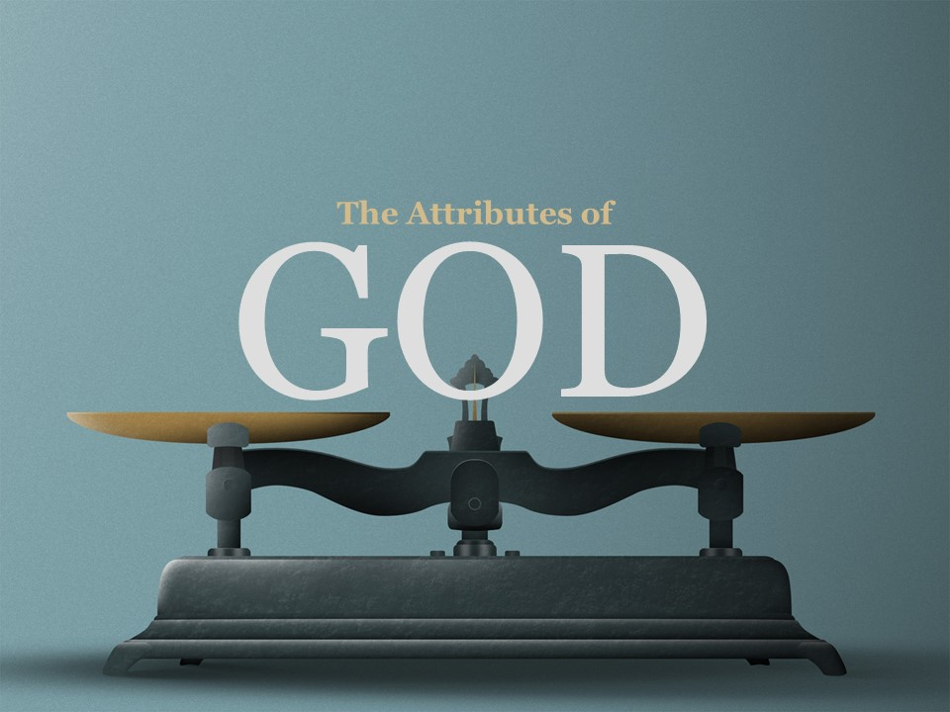
GOD
The Attributes of

Slide 2
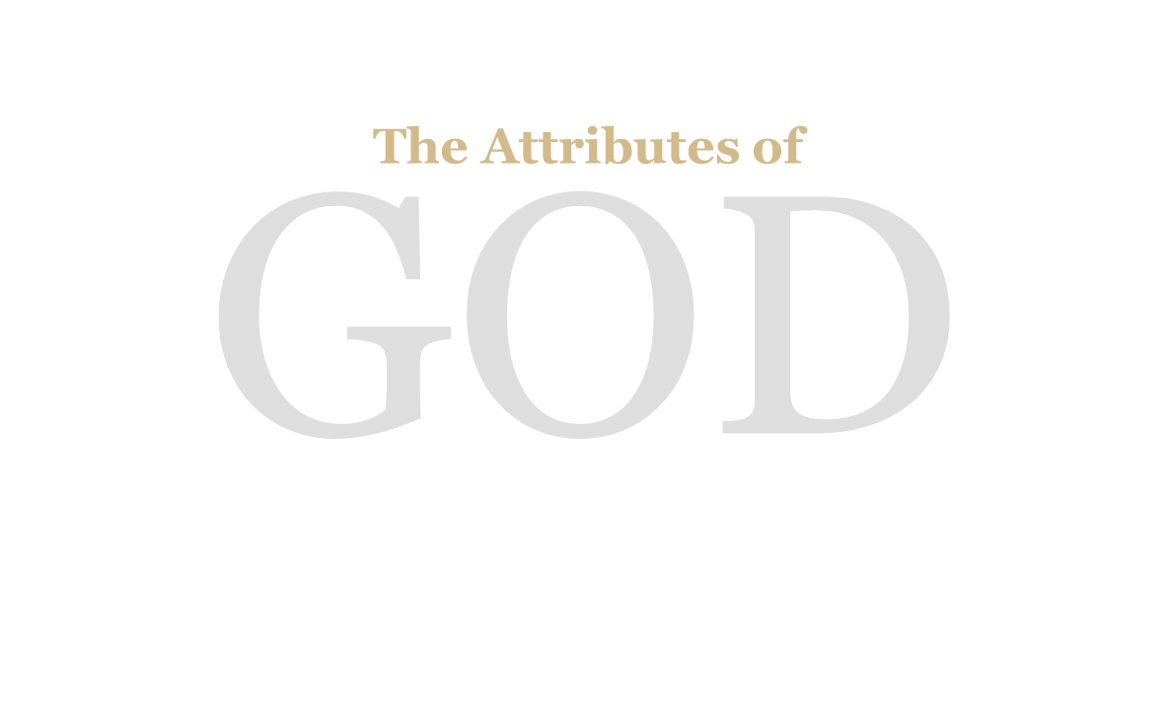
Attributes are defined as the characteristics and qualities of God. As water is wet and fire is hot, so God is eternal, immutable, holy, etc. These attributes are classified into two classes:
1. The Natural Attributes;
2. The Moral Attributes.

Slide 3
A distinction should be clearly made between an attribute and that which is the very essence of God.
To illustrate this let us consider water. Water is H2O, but water is wet. An attribute of water is that it is wet. However, H2O is not an attribute.
Even so God is immutable which is an attribute, but God is Spirit which should not be considered as an attribute.

Slide 4
"Thou knowest my downsitting and mine uprising thou understandest my thought afar off" (Psalm 139:2-3).
"The eyes of the Lord are in every place, beholding the evil and the good" (Proverbs 15:3).
"Known unto God are all his works from the beginning of the world" (Acts 15:18).

Slide 5
The omniscience of God means that God is perfect in knowledge; He knows everything.
In a later lesson a study will be made of the foreknowledge of God. We must not confound the foreknowledge of God with His foreordination.
The fact that God knows a thing makes that thing certain but not necessary. Man still has the responsibility for his own acts.

Slide 6
"Is anything too hard for the Lord?" (Genesis 18:14).
"I know that thou canst do anything." (Job 42:2).

Slide 7
The omnipotence of God means that God is perfect in power. God's power admits neither bound nor limitations.
Satan has no power over any of God's children only as God permits. God raises up a standard against Satan just as He sets a barrier to the waves of the sea (Job 1:12; Job 2:6; Luke 22:31-32).

Slide 8
"Whither shall I go from thy spirit? Or whither shall I flee from thy presence? If I ascend up into heaven, thou art there: if I make my bed in hell, behold, thou are there" (Psalm 139:7-8).
"Do not I fill heaven and earth? saith the Lord." (Jeremiah 23:24).

Slide 9
The omnipresence of God means that God is everywhere at all times. His center is everywhere; His circumference is nowhere.
God is never so far off as even to be near; He is within. Our spirit is the home He holds most dear.

Slide 10
"But as he which hath called you is holy, so be ye holy in all manner of conversation; Because it is written, Be ye holy; for I am holy." (I Peter 1:15-16).
"And one cried unto another, and said, Holy, holy, holy, is the Lord of hosts; the whole earth is full of his glory." (Isaiah 6:3).
"I will help thee, saith the Lord, and thy redeemer, the Holy One of Israel." (Isaiah 41:14).

Slide 11
The holiness of God is the attribute with which God would have us remember Him more than any other. The visions, which God gave to Job, Moses and Isaiah, speak of God as "The Holy One.“
It is because of this attribute more than others that God cannot fellowship with sinful man.

Slide 12
The holiness of God demanded that the blood of millions of lambs, goats, bullocks, turtle doves, etc. be shed whereby man may approach unto God, in the New Testament we can only approach God through the blood of the man Christ Jesus.
The construction of the Tabernacle, the Ten Commandmens, the Law all speak to God’s holiness.

Slide 13
God hates sin and to him it is vile and detestable. The infinite distance between the sinner and God is because of sin.
The sinner and God are at opposite poles of the moral universe. Herein lies the need of atonement whereby this awful distance is bridged.
We shall have right views of sin when we get right views of God's holiness.

Slide 14
"I am the Lord, I change not" (Malachi 3:6).
"Every good gift and every perfect gift is from above and cometh down from the Father of lights, with whom is no variableness, neither shadow of turning" (James 1:17).

Slide 15
The immutability of God means that God does not change. Time and change together are denied of God.
There is no past, present, or future with God. Everything is one great living present. It is not possible that God should possess an attribute at one time that He does not possess at another.

Slide 16
"And God said unto Moses, I AM THAT I AM" (Exodus 3:14).
"From everlasting to everlasting, thou art God" (Psalm 90:2).
"Art thou not from everlasting, O Lord my God?" (Habakkuk 2:12).

Slide 17
The eternity of God is closely connected to that of immutability. It simply means that God dwells in eternity and time has no effect upon Him. With Him there is no past nor future but one eternal present.
"I AM" is one of the greatest titles of our Lord. The past, present, and future lie in these words. "I AM" means "The Eternally Present One; The Self-Existent One."

Slide 18
"God is love; and he that dwelleth in love dwelleth in God, and God in him." (I John 4:16).
"For God so loved the world, that he gave his only begotten Son, that whosoever believeth in him should not perish, but have everlasting life" (John 3:16).
"But God commendeth his love toward us, in that, while we were yet sinners, Christ died for us" (Romans 5:8).

Slide 19
The love of God is greater than human comprehension. It is beyond measure and understanding.
The love of God is of such a nature that it is extended to all men everywhere at all times. He loves every man regardless of color, nationality, and culture.
He does not love the sins and habits of man but He loves the soul of man, and He constantly has the physical and spiritual welfare of man at heart.

Slide 20
"Gracious is the Lord, and righteous; yea our God is merciful." (Psalm 116:5).
"The Lord is righteous in all his ways, and holy in all his works." (Psalm 145:17).

Slide 21
The attributes of righteousness and justice are further expressions of God's holiness.
Because God is righteous there is an imposing of righteous laws and demands upon his children; because God is just there is an executing of penalties, which are attached to these laws.
God always does that which is right, and His justice is free from all passion and vindictiveness.

