Slide 1
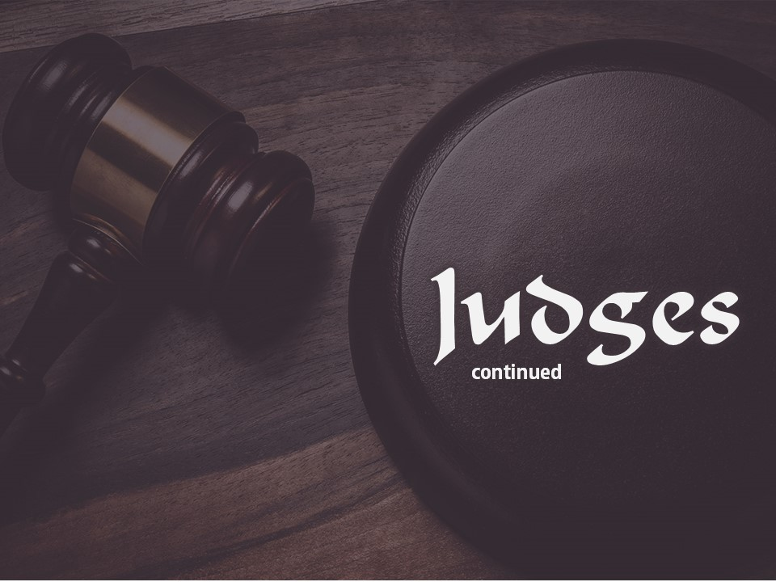
Judges
continued

Slide 2
The First Servitude
The people of Israel served the Lord as long as Joshua lived and also as long as the elders lived who saw the miracles of God under the ministry of Joshua (Judges 2:7).
However, soon after they began their decline into Apostacy.

Slide 3
The First Servitude
This was an invasion from Mesopotamia and the name of the leader was Cushan Rishathaim.
He was the only oppressor who came from such a distant land.
During this first servitude the Israelites were kept in bondage for a period of eight years.
The deliver was Othniel.
The first judge was a younger brother of Caleb (Joshua 15:17).

Slide 4
The Second Servitude
The second nation to oppress Israel was the nation, Moab.
Moab lay immediately across the Dead Sea from Judah.
It was their king, Balek, who had brought Balaam from the north to curse Israel.

Slide 5
The Second Servitude
This servitude continued for eighteen years.
The king of the Moabites was Eglon, who was a very fat man.
When Israel cried to God for help, the Lord raised up another deliverer, Ehud of Benjamin.

Slide 6
The Third Servitude
The third oppression came from the Canaanites within Palestine, whom the Israelites should have driven out in the first place.
Jabin, king of Hazor, was the leader, and Sisera was his general.
The city of Hazor had been defeated by Joshua but again had become strong.
Sisera had 900 chariots of iron.

Slide 7
The Third Servitude
This time Israel's deliverer was a woman.
Deborah was both a judge and a prophetess (Judges 4:4).
The people came to her for counsel.
She received people under a palm tree between Ramah and Bethel, some sixty miles south of where the battle with Sisera would take place.

Slide 8
The Third Servitude
She called Barak who lived in the north in Kedesh of Naphtali.
She instructed him to raise an army of 10,000 men from Zebulum and Naphtali and to fight Sisera.
Barak agreed to do so if she would go with him.
Deborah consented and they fought Sisera west of Megiddo on the banks of the Kishon.
The Lord miraculously gave victory and Sisera fled northward.

Slide 9
The Fourth Servitude
After a period of forty years, the old corruption broke out again.
Another invasion was sent as punishment.
The Midianites, aided by Amalekites and "children of the east," came pouring into the land each year at the time of harvest.
They plundered the country and depleted the land of both livestock and grain.

Slide 10
The Fourth Servitude
God's first commandment to Gideon was to destroy this idolatrous altar.
This he did showing courage and faith.
The people first wanted to kill Gideon but later accepted him as leader.
When he called for troops to fight the Midianites there were 32,000 who responded from the tribes of Manasseh, Asher, Zebulum, and Naphtali.

Slide 11
The Fourth Servitude
He was left with 300 men. Gideon armed his men with trumpets and empty pitchers containing lamps.
All blew the trumpets and broke the pitchers at the same time.
The enemy was taken by surprise and fled in panic.
Gideon was invited to become the King of Israel but he would not listen to the proposal. He knew that God was Israel's King.

Slide 12
The Fifth Servitude
The Ammonites ravaged the tribes east of Jordan and Judah, Benjamin and Ephraim, west of Jordan.
When the children of Israel cried out for deliverance, God taunted them, telling them to cry to their heathen gods.
Finally the Israelites showed the fruit of repentance and put away the strange gods.
God then raised up Jepthah to be their deliverer.

Slide 13
The Sixth Servitude
The Philistines brought the last great oppression.
They were able to impose their will on Israel for forty years, the longest of any of the oppressions.
God's man to fight against the Philistines was Samson.

Slide 14
The Sixth Servitude
Samson was to be a Nazarite.
He was never to drink wine or strong drink, and never to cut his hair.
He enjoyed great physical strength, but he proved to have a weak will.

Slide 15
The Sixth Servitude
Some of his feats of strength were:
1. Killed a lion with his bare hands;
2. Slew thirty Philistines taking their changes of clothing;
3. Caught 300 fox and tied firebrands to their tales and burned the Philistine crops;
4. Killed 1,000 Philistines with the jawbone of an ass.

Slide 16
The Sixth Servitude
Samson served as judge for twenty years until he fell victim to lust and sinned with a harlot (Judges 16:1-3).
He finally lost his hair, and was blinded and lost his strength.
Later, when his hair had grown out, he accomplished the great feat of pulling down the temple of the Philistines, killing them and himself.

Slide 17
Civil Wars
1. The Jealousy of Ephraim: (Judges 8:1-32).
The Ephraimites were jealous of Gideon and refused to give him and his men food when they were faint and weak.
When the battle against Midian was completed, Gideon fought and subdued the Ephraimites.
This was the beginning of a deep-rooted division in Israel that finally ended in the division of the kingdom under Jeroboam and Rehoboam.

Slide 18
Civil Wars
2. Abimelech: (Judges 9:1-52).
Abimelech's ambition to set up a dynasty led to a civil war.
3. The Second Jealousy of Ephraim: (Judges 12:1-7).
Ephraim was jealous again following Jephthah's victory over the Ammonites.
This terminated in the slaughter of the Ephraimites who could not say "Shibboleth."

Slide 19
Civil Wars
4. The Punishment Of Benjamin: (Judges 19 - 21).
The tribe of Benjamin was severely punished because of a lewd crime.
The entire tribe was almost destroyed because of this.

