Slide 1
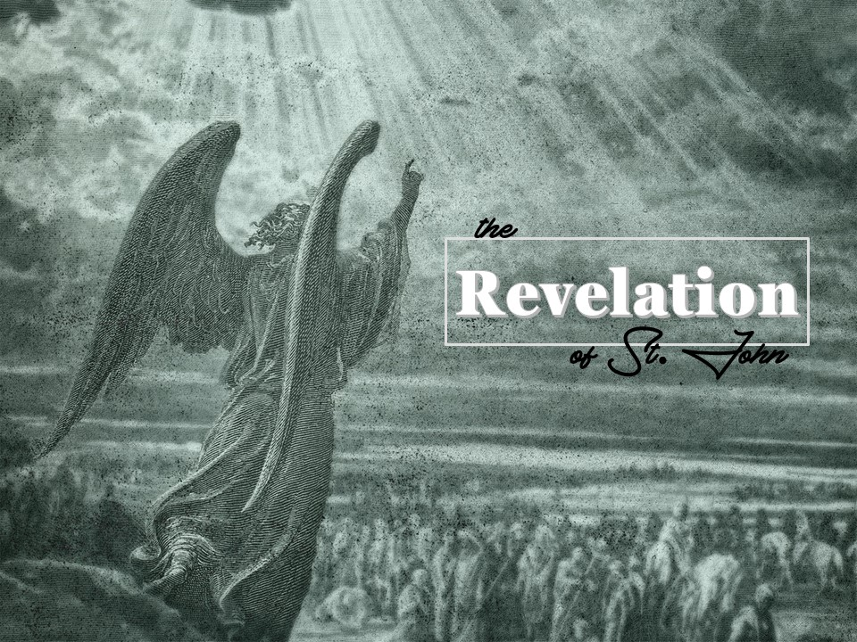
Revelation
the
of St. John

Slide 2
Revelation
The word "Revelation" comes from the Latin "revelatio" which means to reveal or unveil.
The title was given to the book in the Latin Vulgate. The Greek title is "Apocalypse" taken from the first word in the Greek text "Apokalypsis."
The meaning is the revealing of something previously hidden such as removing a veil from a statue or picture.

Slide 3
The Writer
John was the beloved disciple, the son of Zebedee.
He had previously written the gospel and his three epistles.
It is believed that the book was written in the year AD 96.
By this time John was a very old man, the only apostle who was still living.
When he wrote the book, he had been banished to the isle of Patmos.

Slide 4
The Writer
This command to write was repeated many times throughout the book:
"… What thou seest write in a book…" (Revelation 1:11). "
"Write the things which thou hast seen…" (Revelation 1:19). "
"… Write, Blessed are the dead which die in the Lord…" (Revelation 14:13).
"… Write, Blessed are they which are called…" (Revelation 19:9).

Slide 5
The Writer
In the second and third chapters he was instructed to write to each of the seven churches. Not only was John commanded to write but also Jesus Christ told John exactly what to write.

Slide 6
A Book of Prophecy
The book of Revelation is a book of Prophecy as stated in several places throughout the book:
"Blessed is he that readeth, and they that hear the words of this prophecy…" (Revelation 1:3).
"… In the days of their prophecy…" (Revelation 11:6).
"… For the testimony of Jesus is the spirit of prophecy." (Revelation 19:10).
"… Blessed is he that keepeth the sayings of the prophecy of this book" (Revelation 22:7).

Slide 7
A Book of Prophecy
"Seal not the sayings of the prophecy of this book…" (Revelation 22:10).
"… The words of the prophecy of this book…" (Revelation 22:18).
"… The words of the prophecy of this book…" (Revelation 22:19).
Revelation is a prophetical book and as such reveals the future.

Slide 8
Interpretations
There have been many methods of interpretations of Revelation. We shall mention four of these methods:
PRETERIST: This is a claim that the greatest part of the book has already been fulfilled in the early history of the church.
HISTORICAL: This is a claim that the book deals with the whole period of church history from John's time to the end of the world.

Slide 9
Interpretations
SPIRITUALIST: This interpretation spiritualizes the teaching of the book and separates the teaching of the book from any historical events.
FUTURIST INTERPRETATION: This is the correct interpretation, which affirms that the major part of the book deals with what is still future. Apart from the first three chapters the book deals with the Lord's coming and the judgments that will still take place.

Slide 10
Plan of the Book
The key to the book of Revelation is given in Revelation 1:19. "Write the things which thou hast seen, and the things which are, and the things which shall be hereafter.“
Here is stated the three clear divisions of the book which do not overlap:
The things which thou hast seen (Ch. 1)
The things which are (Ch. 2-3)
The things which shall be hereafter. (Ch. 4-22)

Slide 11
Promise of Blessing
"And he saith unto me, Seal not the sayings of the prophecy of this book" (Revelation 22:10).
"Blessed is he that readeth, and they that hear the words of this prophecy, and keep those things which are written therein" (Revelation 1:3).
"Blessed is he that keepeth the sayings of the prophecy of this book" (Revelation 22:7).

Slide 12
Promise of Blessing
God would never have promised these blessings if the book were a mystical book that could not be understood. The book could never be obeyed if it could not be understood. God planned that the prophecy should be read with clear understanding.

Slide 13
Climax of God’s Revelation of Truth
As Genesis gives understanding concerning the beginning of everything, Revelation teaches concerning the consummation of all things. We might compare the two books:

Slide 14
Climax of God’s Revelation of Truth
GENESIS
Paradise lost
The first city, a failure
Beginning of the curse
Marriage of the first
First tears
Satan's entrance
Old creation
Communion broken

Slide 15
Climax of God’s Revelation of Truth
REVELATION
Paradise regained
City of the Redeemed
No more curse
Adam Marriage of the second Adam
Every tear
Satan's doom wiped away
New creation
Communion restored

Slide 16
The Number Seven
The number seven is God's number of perfection and completion in the book of Revelation.
There are SEVEN SEVENS that we might study as we read this wonderful book.

Slide 17
The Number Seven
Seven Churches Revelation 2:1 - Revelation 3:22.
Seven Seals Revelation 6:1 - Revelation 8:5.
Seven Trumpets Revelation 8:7 - Revelation 11:19.
Seven Personages Revelation 12:1 - Revelation 13:18.
Seven Vials Revelation 15:1 - Revelation 16:21.
Seven Judgments Revelation 17:1 - Revelation 20:15.
Seven New Things Revelation 21:1 - Revelation 22:5.

Slide 18
How to Read and Understand the Book
We must keep clear in mind that John recorded those things he saw and heard, as they were unfolded before him.
When we refer to a literal interpretation, we simply mean the 144,000 were 144,000 not just a symbolical number. New Jerusalem is a real city. The millennium is real. There will be one thousand years in Christ's Kingdom upon earth.
Keeping these principles in mind, this book becomes an exciting, challenging study. Just as the Lord promised, we can be blessed throughout our study of this wonderful prophecy.

