Slide 1
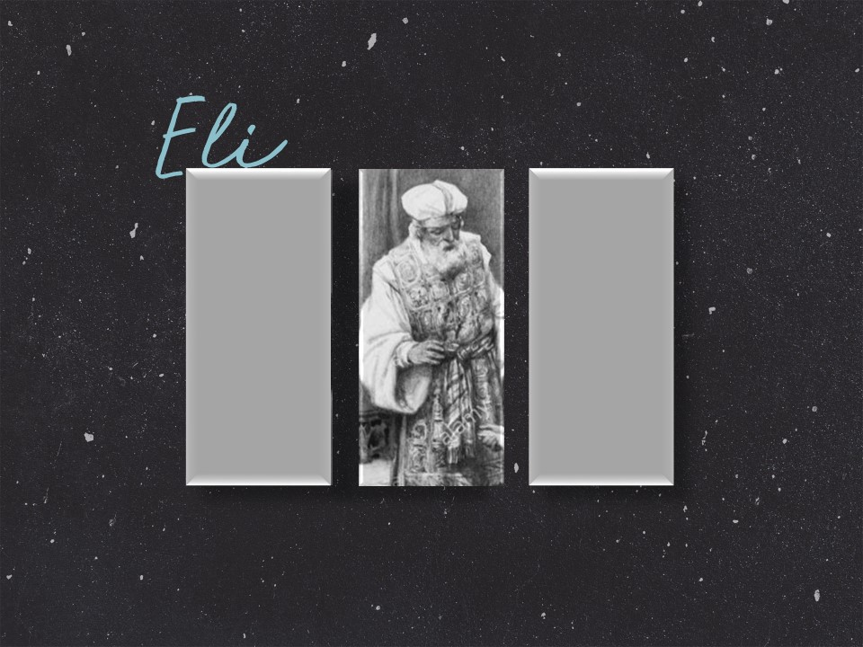
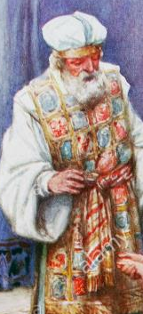
Eli

Slide 2

The Priest Eli
Eli was a priest of the line of Ithamar.
Ithamar was the younger son of Aaron.
A line of priests descended from his other son, Eleazar, but Eli was a descendent of Ithamar.

Slide 3
Eli’s Piety
His piety is shown by his meek submission to God's will as expressed in I Samuel 3:18, his reverential regard for the ark of God (I Samuel 4:18), his willingness to take and train the young child, and his discernment of the moving of the spirit of God (I Samuel 3:8-9).

Slide 4
Eli’s Piety
Eli served Israel during a period of decided spiritual decline.
Eli dwelt in Shiloh at the house of the Lord.
Not everyone in Israel had turned their backs on God but it was then as it is now, salvation was personal and not national.

Slide 5
Eli’s Negligence
Eli completely failed in training his own sons.
They were wicked men sorely perverting the ritual and profaning the sanctuary in a debauchery similar to that of Canaanite temples.

Slide 6
Eli’s Negligence
As a result people abhorred to come to worship.
God held Eli responsible for this and the sin of his boys brought judgment upon Eli and the entire nation.

Slide 7
Eli’s Negligence
"One that ruleth well his own house, having his children in subjection with all gravity; (For if a man know not how to rule his own house, how shall he take care of the church of God?)" (I Timothy 3:4-5).

Slide 8
Eli’s Death
Punishment came through a terrible battle with the Philistines.
The people thinking the that presence of the ark at the battle front would help in fighting, and with permission from Hophni and Phinehas, took the ark from Shiloh.

Slide 9
Eli’s Death
30,000 men of Israel fell including Hophni and Phinehas and the ark was captured.
When news of this catastrophe reached Shiloh, Eli fell from his seat, backward and died of a broken neck.

Slide 10
The Ark Taken By the Philistines
The ark of the tabernacle had been captured in the battle of Aphek, but was returned to Israel just seven months after its capture.
The image of Dagon had twice been made to fall to the floor.
Painful tumors had been inflicted on the people.

Slide 11
The Ark Taken By the Philistines
The land had been overrun with mice.
The Philistine priests thought of a plan in which to test God, by placing the ark on a new cart drawn by young heifers.

Slide 12
The Ark Taken By the Philistines
God intervened so that these young heifers drawing the wagon unbroken with their calves taken from them had wondrously moved straight along the road to Bethshemesh in Israelite territory.

Slide 13
The Ark Taken By the Philistines
Instead of sending it back to the tabernacle, the Bethshemites sent for men of Kirjath-jearim to come and get it.
These people handled it properly because they experienced no harm but they still did not return it to the tabernacle.

Slide 14
Icahbod
The wife of Phinehas was ready to bear a child when the news came of the death of her husband.
She immediately gave birth to her child and died in childbirth.

Slide 15
Icahbod
Before her death she named the child Ichabod.
The word means: "The glory is departed from Israel."

