Slide 1
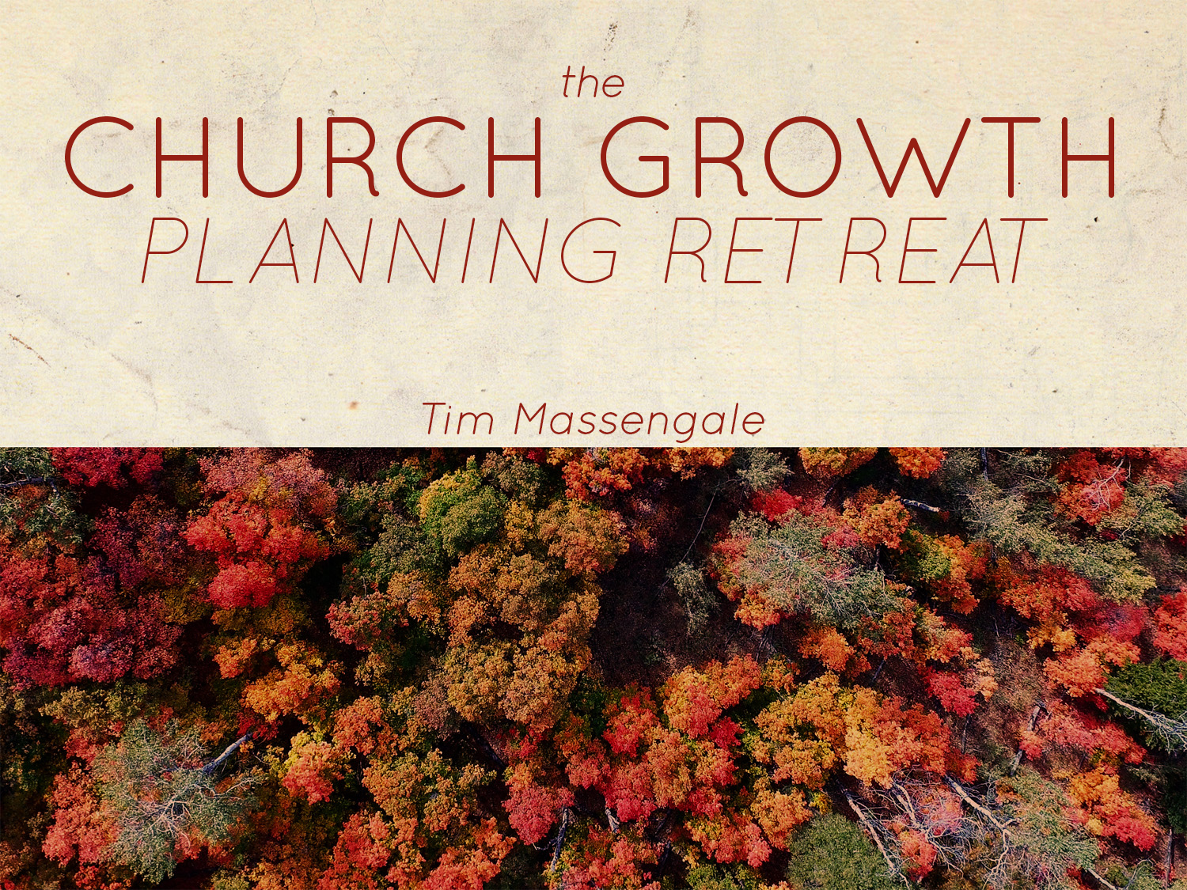

Slide 2
Introduction
A church in desperate need of some excitement and enthusiasm
Had lost their vision for growth, winning souls, and reaching their city
Outreach, attendance and home bible study involvement had dropped
Pastor decided to have a church growth planning retreat to help bring back life to his congregation
Five years later, his attendance has doubled

Slide 3
What A Church Growth Planning Retreat Will Do
Excitement and Enthusiasm
  New plans, fresh ideas, worthwhile goals, always spark the thrill of being part of a program that carries eternal purpose - when you get excited, your people get excited with you
Commitment to Involvement
  People are more committed to a plan when they have a hand in its development.
  The planning retreat allows them to voice their ideas and solutions to various situations - makes the plans "ours" instead of "yours"

Slide 4
What A Church Growth Planning Retreat Will Do
A Team Spirit
  The retreat will help the directors bind together and work together as a team to find solutions to difficult problems, set goals and make improvements
Coordination of Activities
  The retreat is a time to look at the entire year and discuss what events from each department need to take place – great way to avoid conflicts with other departments
A Reward for a Job well done
  The retreat is a great way to make directors feel needed and important – that their advice and ideas are desired and needed

Slide 5
When, Where, Who, and How
When
  The planning retreat should be an annual event
    August, October, November is a great time
Where
  The retreat, to be effective, is best held as an out of town and overnight event
    Having is out of town makes it seem least like work
Who
  The retreat should be attended by all department heads and their spouses

Slide 6
When, Where, Who, and How
How
  Type up an agenda giving each department between 30 – 50 minutes of group discussion time
  Discussion topics should be the type that encourages group discussion
    They should address needs, problems, and improvements

Slide 7
Conclusion
Effective planning takes time
Good planning requires extended periods of quality time, the right people, a comfortable environment, and adequate preparation
Church Growth Planning Retreat provides just that sort of environment
  The retreat brings everyone together, all working for a common goal
  The result is more souls being added into the Kingdom of God

