Slide 1
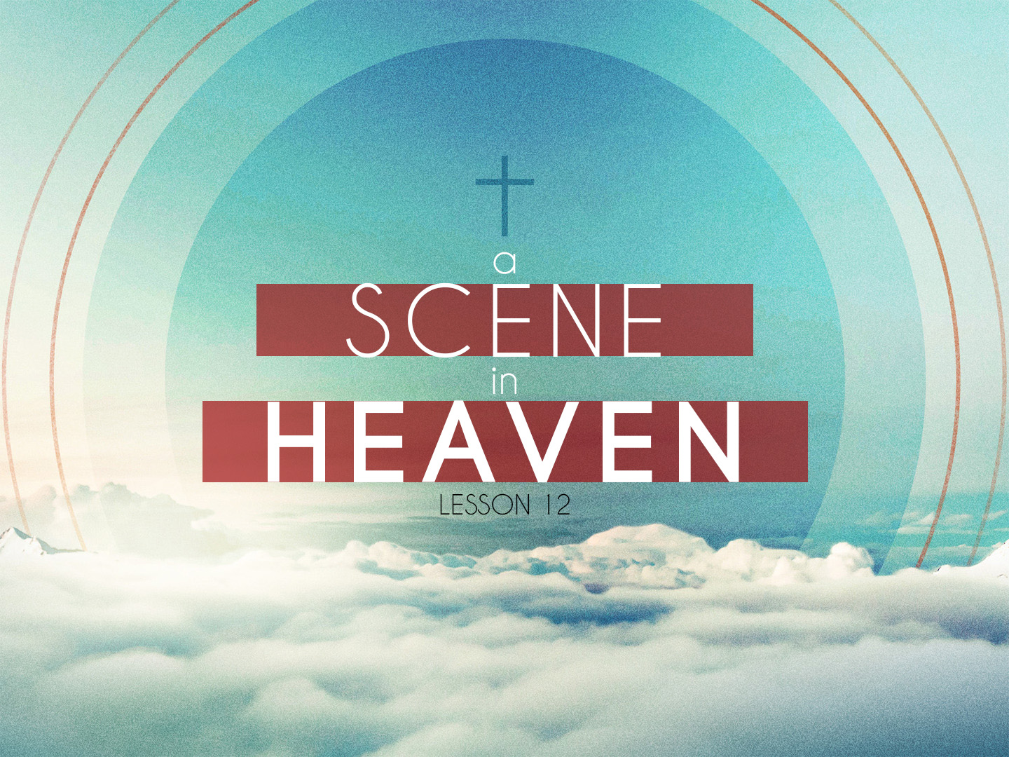

Slide 2
The Church Raptured
The words "After this" follow the 2nd and 3rd chapters, which deal with the church
  Some people are already speaking about the present time as being the "post church" age
  The church is still here but we shall soon enter the "post church" age

Slide 3
The Church Raptured
  The church is mentioned sixteen times in Revelation, yet no other place in Revelation can we find the church resident upon the earth
  The rapture of the church is clearly taught in the Bible

Slide 4
The Church Raptured
  There are two promises given to the church that she will not have to go through the Great Tribulation:
  Luke 21:36
  Revelation 3:10

Slide 5
The Church Raptured
  John looked and he saw a door opened in heaven. The order of events is important
  John looked and then the door opened
  In the rapture of the church, Jesus is coming for them who look for Him

Slide 6
The Church Raptured
  Looking for the Lord's return is a necessary conditions of being ready
  John is caught up in the spirit
  John is given a vision of what will take place in heaven when the church is raptured

Slide 7
The Scene In Heaven
  The central place, which drew John's attention, was the throne
  There was only one throne and one sat upon the throne
  There is only one God and He is Jesus Christ, our Lord and Savior

Slide 8
The Scene In Heaven
  His description is likened unto that of precious stones, jasper and sardine
  The jasper stone is a brilliant stone like a diamond
  The sardine stone is blood red
  This is the throne of judgment for the world during the Tribulation

Slide 9
The Scene In Heaven
  The red stone speaks of God's wrath. However, around the throne is an emerald rainbow, which is green. This green rainbow speaks of mercy
  There is no rainbow around the Great White Throne
  Only here during the Tribulation will judgment be administered tempered with mercy

Slide 10
The Scene In Heaven
  There were four beasts on each side of the throne
  The word "beasts" actually means, "living creatures."
  They had the appearance of a lion, calf, man and an eagle
  Their main purpose is to worship God day and night

Slide 11
The Scene In Heaven
  Around the throne twenty-four elders were seated
  These elders represent the entire church
  They are clothed in white and have crowns of gold upon their heads
  Their song identifies them as being representative of the church

Slide 12
The Scene In Heaven
  Seven Lamps and Sea of Glass:
  Out of the throne came lightning and thunder, which speak of judgment
  Before the throne were seven lamps which are the seven spirits of God
  The number seven means perfection
  The sea of glass is an area of peace and tranquility before the throne

Slide 13
One Throne
  There is only one God in Heaven
  We shall see Jesus (I John 3:2). The One who is seated upon the One Throne is Jesus Christ

Slide 14
One Throne
  John saw Jesus take the sealed book out of the right hand of Him upon the throne
  This is not the only place we see our Lord revealed occupying more than one office at the same time

Slide 15
Title Deed To The Earth
  In the right hand of God was the title deed to the earth
  This was a scroll, which contained the terms of redemption of the earth
  The book or scroll, sealed with seven seals, recalls an ancient Jewish custom
  A sealed book was a sign of an alienated inheritance

Slide 16
Title Deed To The Earth
  When the legal representative of the original property holder broke the seals and brought back the property, he was called the "Redeemer."
  The time comes when the Lord Jesus fulfills the promises of God, executes the judgments and gives the inheritance to the saints.

Slide 17
Redeemer Of The Earth
  A redeemer must have these qualifications:
    Be a near kinsman
    Have the price
    Be willing

Slide 18
Redeemer Of The Earth
  John wept when there was no man worthy to break the seals and meet the conditions
  He was told not to weep for the Lion of the tribe of Judah hath prevailed to open the book

Slide 19
Redeemer Of The Earth
  John saw Jesus having seven horns and seven eyes
  This reveals Jesus possessing the attributes of omnipotence and omniscience
  Only Jesus, the Lamb who was slain at Calvary, was found worthy to take the book, break the seals, and redeem the earth from the curse

