Slide 1
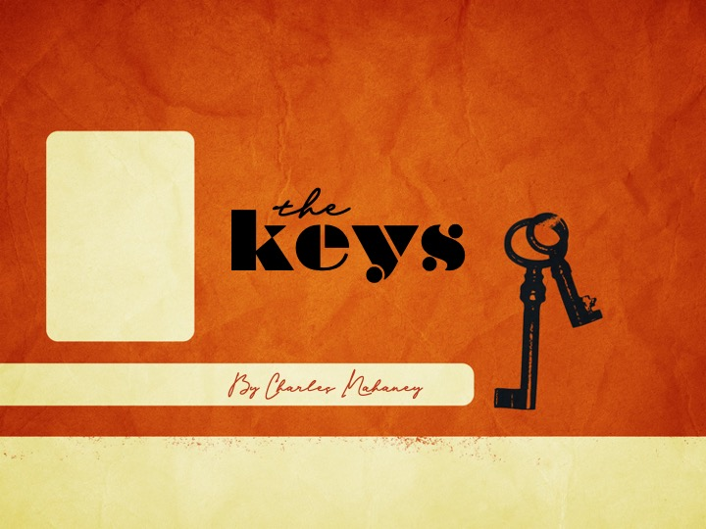
keys
the
By Charles Mahaney

Slide 2
There is nothing as forlorn and lonesome as an old, empty house, unless it is an empty life.
The new-birth experience, or being born again, brings God's transforming power into the deepest depth in a life. It transforms thoughts, actions, affections, and the will of the whole inward man.
We cannot consecrate and change unless there is a power within us that is greater than the power that is in this world.

Slide 3
The words spilled into the night air of Jerusalem from the lips of Jesus, "Ye must be born again" (John 3:7). The Savior of the world, the long-awaited Messiah, looked the man Nicodemus in the face and spoke these words to the ages.
This man was a member of the Sanhedrin, the religious supreme court of Israel. To be a member of this religious body, a man had to be without a flaw in his life.

Slide 4
Being born again is receiving God’s Spirit. It is the impartation of God's nature into us that makes us able to become the sons of God. It is new life flowing into a spiritually dead soul.
New birth is a union of our souls with Jesus. The past has no future to those who are willing to be swept from the immediate to the transcendent, from the natural to the supernatural by this new life in God.

Slide 5
The exchange Adam made by his rebellion is stamped into the DNA of every soul. He exchanged the glory of God for the lie of a serpent. He became more like the snake and less like God.
In each person the tarnished image of Adam's rebellion exists, and like Nicodemus, it is sometimes covered by religious action.

Slide 6
In Adam something changed. Through the ages, man has lived in the consequences of a moment's choice. In Genesis 3:9, God called to His creation, "Adam, . . . where art thou?" God had become more than a distant deity. He had become man's pursuer.
Throughout the Scriptures we find God looking for and pursuing that which He had created.

Slide 7
He calls to each of us, hoping we will step back into unbroken fellowship with Him. He knows every man's address, and He wants us more than we want Him.
Circumstances become a purpose in the hand of God. Without the new birth, we are a husk without the grain and a shell without the kernel, full of nothing but emptiness.

Slide 8
In the Old Testament, as the Israelites were delivered from Egypt, they were surrounded by a cloud which was the glory of God's presence.
In the New Testament, we are surrounded with a great cloud of witnesses.
In the New Testament we find Mary Magdalene, out of whom Jesus cast seven devils, Zacchaeus, who sold out his own people for money, and the woman at Sychar, who had been married five times and was living in her sixth relationship in a common-law situation.

Slide 9
The Bible tells us that God is completely and fully revealed in Jesus.
Jesus said, "The words that I speak unto you, they are spirit, and they are life" (John 6:63).
His Word in our hearts is the germ of life, and when obeyed, it brings blessing to our lives. His seeded Word releases the tremendous reservoir of God's life into our lives.

Slide 10
Being born again is more than a certain way of acting within a specific religious institution. It is more than keeping rules and belonging to a particular group.
It is of the Spirit. Flesh is flesh, and flesh must come to terms with God's Spirit. This is what Jesus called the new birth, or being born again. Birth is always a cleansing. It is leaving the old container.

Slide 11
In the natural, the valve in a new baby's heart closes and allows the infant heart to pump on its own, giving blood throughout its body. Each of us has had a physical conception and a physical birth.
Everyone must go through the same process to become a living, breathing person. There is no exception to the rule in this physical world. When we were born into this world, we knew practically nothing concerning it.

Slide 12
A fundamental physical law is that birth brings growth and maturity. This is also true of the spiritual world. New birth is the vital first step in recovery and spiritual maturity. New birth performs the mission of reconciliation.
The new Spirit-life gives the faith to supply what the flesh lacked, and it accepts truth and supplies its need. It makes belief the normal and unbelief the abnormal.

Slide 13
Jesus said the first commandment is "Hear, O Israel; The Lord our God is one Lord: and thou shalt love the Lord thy God with all thy heart, and with all thy soul, and with all thy mind, and with all thy strength: this is the first commandment" (Mark 12:29-30).
In loving Him you will create a throne in your inner spirit for God to enthrone Himself. No other God can sit on the throne with Him. We are always welcome in His throne room because new birth has made us His children.

Slide 14
Jesus turned to Peter one day long ago and asked the probing question, "Whom do men say that I am?" (Mark 8:27). God's manifestation in our lives is limited only by our own manifestation.
However, God's manifestation is hindered when we manifest our human will. One precludes the other. It is when we yield to the lordship of Jesus that God's will begins to work.
Jesus looked and saw Peter the rock in Peter the unstable, and He waited for Peter to reply. Peter said, "[Some say] John the Baptist; but some say, Elias; and others say, that one of the old prophets is risen again" (Luke 9:19).

Slide 15
Jesus let Peter know salvation never rests on what some say of Him. Jesus said unto him, "But whom say ye that I am?" (Mark 8:29).
Because of his answer, Jesus told Peter, "I will give unto thee the keys of the kingdom of heaven" (Matthew 16:19).

Slide 16
Acts exploded and burnt in the city of Jerusalem. The Day of Pentecost came, and the Spirit descended. The Spirit of God put the cry for fulfillment into the lives of men and brought them to the feet of a loving God.
Soon the waves of the new church flowed into the entire world, and Jerusalem was turned upside down. Man could now be set free by the new birth from the chains that Satan had shackled on Adam.

Slide 17
Peter, the spokesman and preacher of Pentecost who had been given the keys to the kingdom of heaven, answered the crowd's question, "Men and brethren, what shall we do?" (Acts 2:37).
Peter used the keys Jesus had given him and unlocked salvation for three thousand souls. This key also fits the lock of your unborn potential in God.

Slide 18
At Cornelius' house, this lock was the hungry spirits of men, and again the key was the message of the cross, death, burial, resurrection, and Pentecost fully come.
In the second chapter of Acts, Peter opened the potential for new birth to the ages (Acts 2:38-39). This is the heartbeat of the Joy of Recovery.

